Slide 1
Unit - 3
Data Link Layer
Prachi Shah
IT Dept.
BVM

Slide 2
Contents
1. | Data link Layer Design Issues | [From Attached PDF]
2. | Error Detection & Correction | [From Forouzan Ch-10]
3. | Types of Errors | [From Forouzan Ch-10]
4. | Error Detection techniques: CRC & Checksum | [From Forouzan Ch-10 & Attached PDF]
5. | Error Correction techniques: Hamming Code | [From Forouzan Ch-10 & Attached PDF]
6. | Elementary Data Link Protocols: Noiseless Channel – Simplex & Stop and wait, Noisy Channel – Simplex Protocol | [From Forouzan Ch-10 & Attached PDF]
7. | Sliding Window Protocols: Stop and wait ARQ, Go-Back-N ARQ, Selective Repeat ARQ | [From Forouzan Ch-10]
8. | Example DLL protocols: HDLC & PPP | [From Forouzan Ch-10 & Attached PDF]
9. | Protocols Verification models | [From Attached PDF]

Slide 3

Chapter 10
Error Detection and Correction
Copyright © The McGraw-Hill Companies, Inc. Permission required for reproduction or display.

Slide 4
10-1 INTRODUCTION
Let us first discuss some issues related, directly or indirectly, to error detection and correction.
Topics discussed in this section:
Types of Errors Redundancy Detection Versus Correction Forward Error Correction Versus Retransmission Coding
Modular Arithmetic

Slide 5

Note
In a single-bit error, only 1 bit in the data unit has changed.

Slide 6
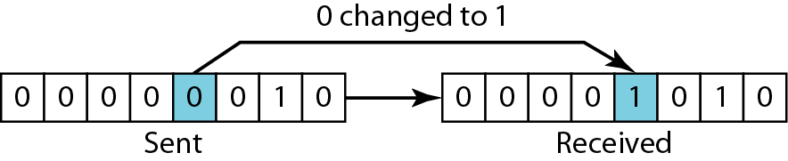
Figure 10.1 Single-bit error

Slide 7
Note
A burst error means that 2 or more bits in the data unit have changed.

Slide 8
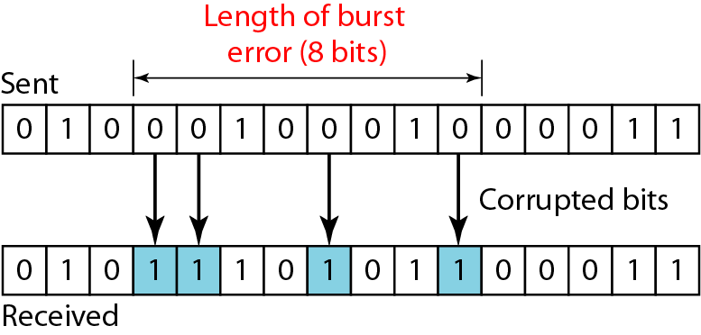
Figure 10.2 Burst error of length 8

Slide 9
Note
To detect or correct errors, we need to send extra (redundant) bits with data.

Slide 10
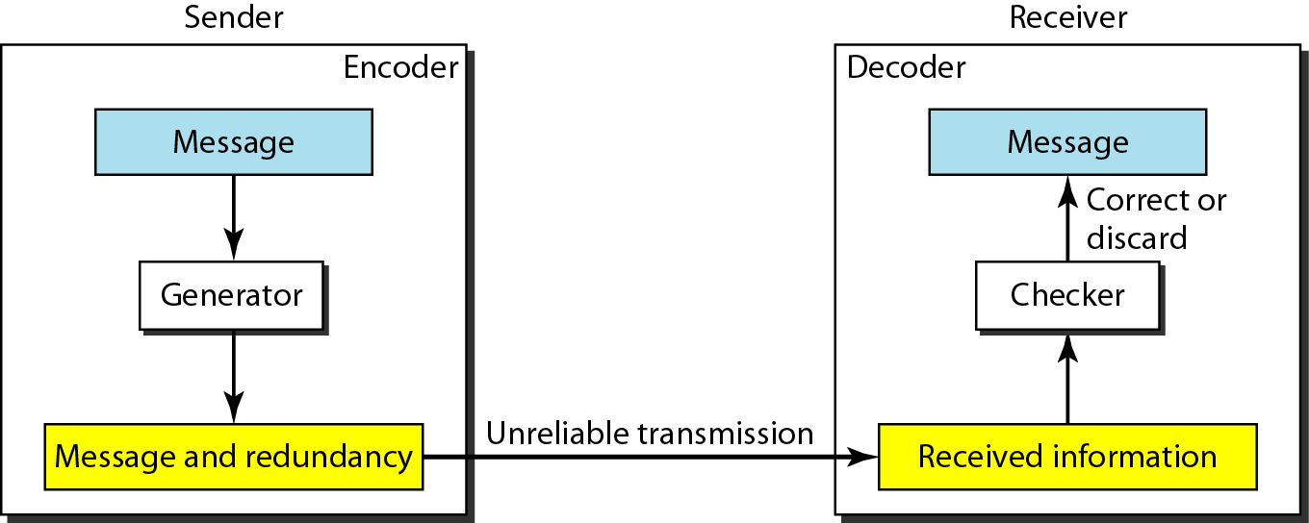
Figure 10.3 The structure of encoder and decoder

Slide 11
Note
In this book, we concentrate on block codes; we leave convolution codes to advanced texts.

Slide 12
Note
In modulo-N arithmetic, we use only the integers in the range 0 to N −1, inclusive.

Slide 13
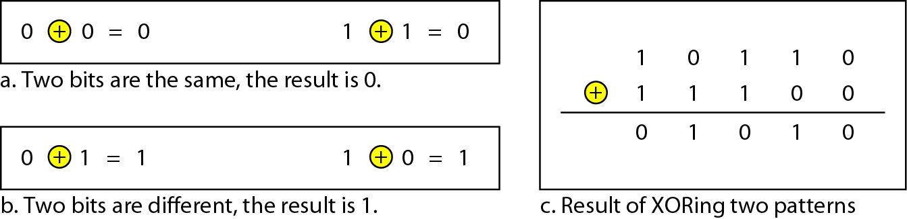
Figure 10.4 XORing of two single bits or two words

Slide 14
10-2 BLOCK CODING
In block coding, we divide our message into blocks, each of k bits, called datawords. We add r redundant bits to each block to make the length n = k + r. The resulting n-bit blocks are called codewords.
Topics discussed in this section:
Error Detection Error Correction Hamming Distance
Minimum Hamming Distance

Slide 15
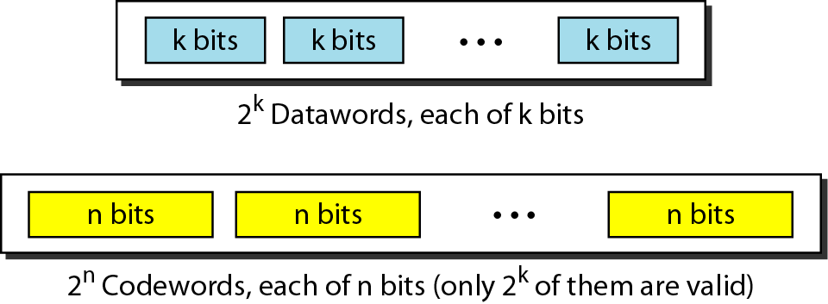
Figure 10.5 Datawords and codewords in block coding

Slide 16
Example 10.1
The 4B/5B block coding discussed in Chapter 4 is a good example of this type of coding. In this coding scheme, k = 4 and n = 5. As we saw, we have 2^{k} = 16 datawords and 2^{n} = 32 codewords. We saw that 16 out of 32 codewords are used for message transfer and the rest are either used for other purposes or unused.

Slide 17
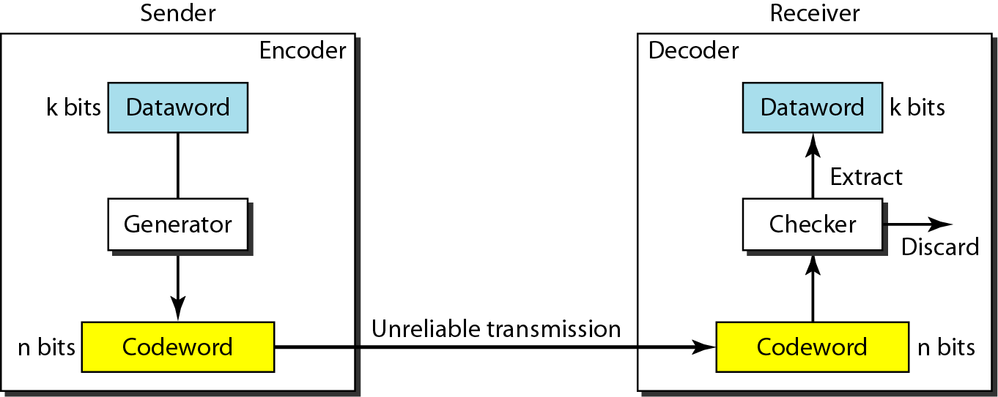
Figure 10.6 Process of error detection in block coding

Slide 18
Example 10.2
Let us assume that k = 2 and n = 3. Table 10.1 shows the list of datawords and codewords. Later, we will see how to derive a codeword from a dataword.
Assume the sender encodes the dataword 01 as 011 and
sends it to the receiver. Consider the following cases:
1. The receiver receives 011. It is a valid codeword. The receiver extracts the dataword 01 from it.

Slide 19
Example 10.2 (continued)
2. The codeword is corrupted during transmission, and 111 is received. This is not a valid codeword and is discarded.
3. The codeword is corrupted during transmission, and 000 is received. This is a valid codeword. The receiver incorrectly extracts the dataword 00. Two corrupted bits have made the error undetectable.

Slide 20
Table 10.1 A code for error detection (Example 10.2)

Slide 21
Note
An error-detecting code can detect only the types of errors for which it is designed; other types of errors may remain undetected.

Slide 22
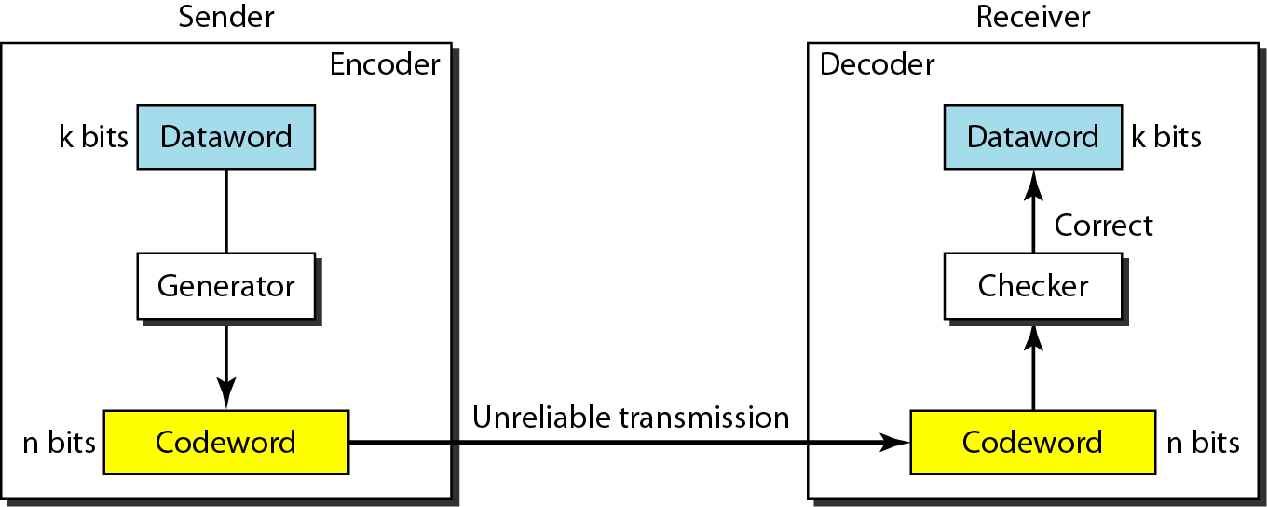
Figure 10.7 Structure of encoder and decoder in error correction

Slide 23
Example 10.3
Let us add more redundant bits to Example 10.2 to see if the receiver can correct an error without knowing what was actually sent. We add 3 redundant bits to the 2-bit dataword to make 5-bit codewords. Table 10.2 shows the datawords and codewords. Assume the dataword is 01. The sender creates the codeword 01011. The codeword is corrupted during transmission, and 01001 is received. First, the receiver finds that the received codeword is not in the table. This means an error has occurred. The receiver, assuming that there is only 1 bit corrupted, uses the following strategy to guess the correct dataword.

Slide 24
Example 10.3 (continued)
1. Comparing the received codeword with the first codeword in the table (01001 versus 00000), the receiver decides that the first codeword is not the one that was sent because there are two different bits.
2. By the same reasoning, the original codeword cannot be the third or fourth one in the table.
3. The original codeword must be the second one in the table because this is the only one that differs from the received codeword by 1 bit. The receiver replaces 01001 with 01011 and consults the table to find the dataword 01.

Slide 25
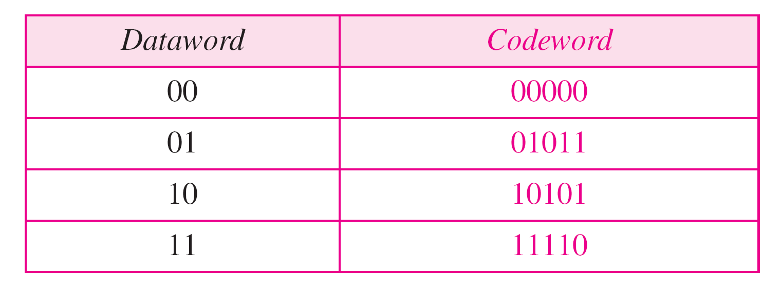
Table 10.2 A code for error correction (Example 10.3)

Slide 26
Note
The Hamming distance between two words is the number of differences between corresponding bits.

Slide 27
Example 10.4
Let us find the Hamming distance between two pairs of words.
1. The Hamming distance d(000, 011) is 2 because
2. The Hamming distance d(10101, 11110) is 3 because

Slide 28
Note
The minimum Hamming distance is the smallest Hamming distance between all possible pairs in a set of words.

Slide 29
Example 10.5
Find the minimum Hamming distance of the coding scheme in Table 10.1.
Solution
We first find all Hamming distances.
The d_{min} in this case is 2.

Slide 30
Table 10.1 A code for error detection (Example 10.2)

Slide 31
Table 10.2 A code for error correction (Example 10.3)

Slide 32
Example 10.6
Find the minimum Hamming distance of the coding scheme in Table 10.2.
Solution
We first find all the Hamming distances.
The d_{min} in this case is 3.

Slide 33
Note
To guarantee the detection of up to s errors in all cases, the minimum
Hamming distance in a block code must be d_{min} = s + 1.

Slide 34
Example 10.7
The minimum Hamming distance for our first code scheme (Table 10.1) is 2. This code guarantees detection of only a single error. For example, if the third codeword (101) is sent and one error occurs, the received codeword does not match any valid codeword. If two errors occur, however, the received codeword may match a valid codeword and the errors are not detected.

Slide 35
Note
To guarantee correction of up to t errors in all cases, the minimum Hamming distance in a block code must be d_{min} = 2t + 1.

Slide 36
Example 10.9
A code scheme has a Hamming distance d_{min} = 4. What is the error detection and correction capability of this scheme?
Solution
This code guarantees the detection of up to three errors (s = 3), but it can correct up to one error. In other words, if this code is used for error correction, part of its capability is wasted. Error correction codes need to have an odd minimum distance (3, 5, 7, . . . ).

Slide 37
10-3 LINEAR BLOCK CODES
Almost all block codes used today belong to a subset called linear block codes. A linear block code is a code in which the exclusive OR (addition modulo-2) of two valid codewords creates another valid codeword.
Topics discussed in this section:
Minimum Distance for Linear Block Codes Some Linear Block Codes

Slide 38
Note
In a linear block code, the exclusive OR (XOR) of any two valid codewords creates another valid codeword.

Slide 39
Note
A simple parity-check code is a single-bit error-detecting code in which n = k + 1 with d_{min} = 2.

Slide 40
Table 10.3 Simple parity-check code C(5, 4)

Slide 41
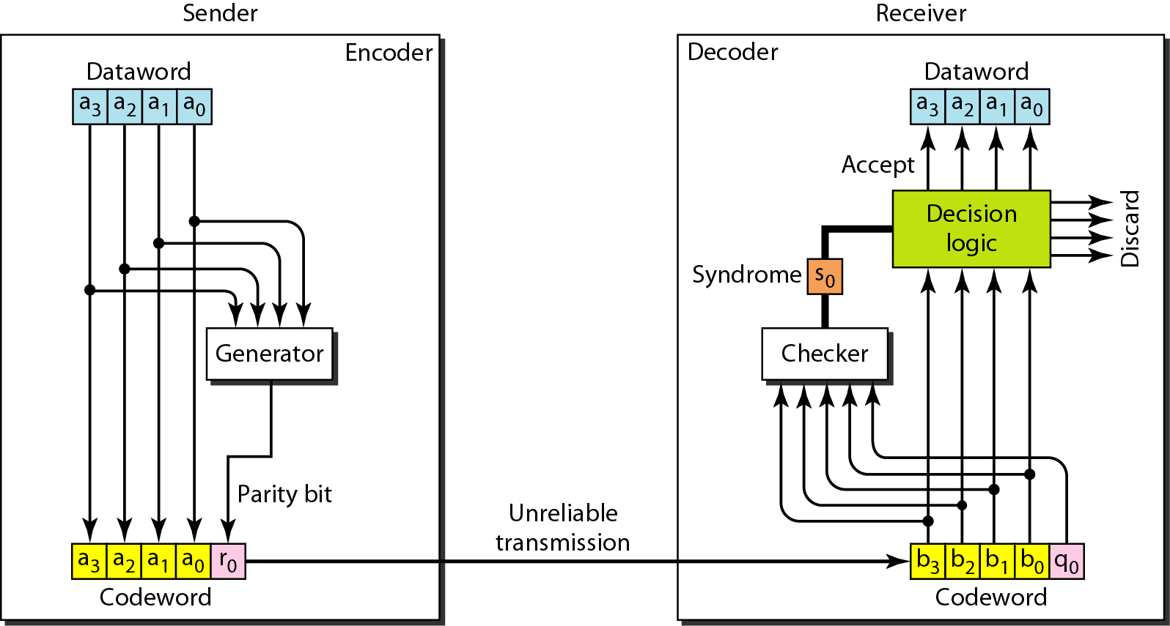
Figure 10.10 Encoder and decoder for simple parity-check code

Slide 42
Example 10.12
Let us look at some transmission scenarios. Assume the sender sends the dataword 1011. The codeword created from this dataword is 10111, which is sent to the receiver. We examine five cases:
1. No error occurs; the received codeword is 10111. The syndrome is 0. The dataword 1011 is created.
2. One single-bit error changes a₁ . The received codeword is 10011. The syndrome is 1. No dataword is created.
3. One single-bit error changes r₀ . The received codeword is 10110. The syndrome is 1. No dataword is created.

Slide 43
Example 10.12 (continued)
4. An error changes r₀ and a second error changes a₃ .
The received codeword is 00110. The syndrome is 0. The dataword 0011 is created at the receiver. Note that
here the dataword is wrongly created due to the
syndrome value.
5. Three bits—a₃, a₂, and a₁—are changed by errors. The received codeword is 01011. The syndrome is 1. The dataword is not created. This shows that the simple parity check, guaranteed to detect one single error, can also find any odd number of errors.

Slide 44
Note
A simple parity-check code can detect an odd number of errors.

Slide 45
Note
All Hamming codes discussed in this book have d_{min} = 3.
The relationship between m and n in these codes is n = 2m − 1.

Slide 46
Table 10.4 Hamming code C(7, 4)

Slide 47
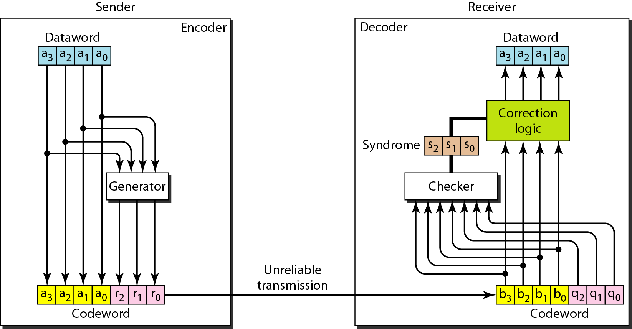
Figure 10.12 The structure of the encoder and decoder for a Hamming code

Slide 48
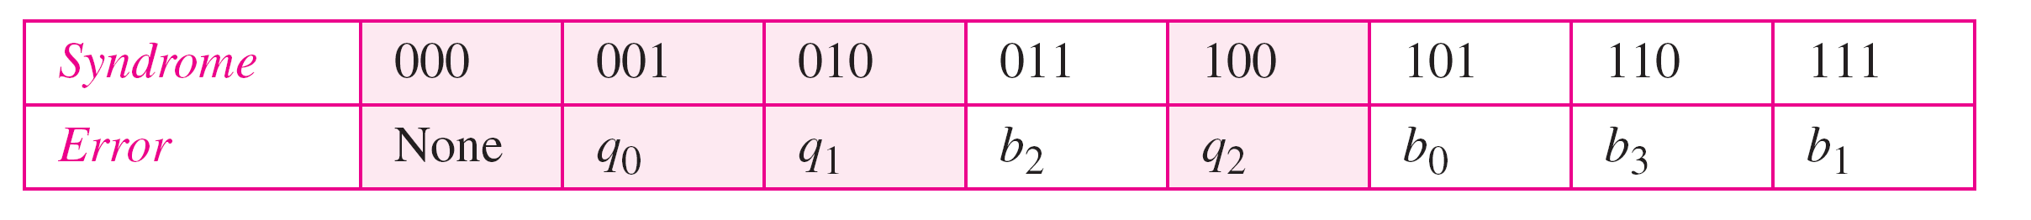
Table 10.5 Logical decision made by the correction logic analyzer

Slide 49
Example 10.13
Let us trace the path of three datawords from the sender to the destination:
1. The dataword 0100 becomes the codeword 0100011. The codeword 0100011 is received. The syndrome is 000, the final dataword is 0100.
2. The dataword 0111 becomes the codeword 0111001. The syndrome is 011. After flipping b₂ (changing the 1 to 0), the final dataword is 0111.
3. The dataword 1101 becomes the codeword 1101000. The syndrome is 101. After flipping b₀, we get 0000, the wrong dataword. This shows that our code cannot correct two errors.

Slide 50
Example 10.14
We need a dataword of at least 7 bits. Calculate values of k and n that satisfy this requirement.
Solution
We need to make k = n − m greater than or equal to 7, or 2m − 1 − m ≥ 7.
1. If we set m = 3, the result is n = 23 − 1 and k = 7 − 3, or 4, which is not acceptable.
2. If we set m = 4, then n = 24 − 1 = 15 and k = 15 − 4 = 11, which satisfies the condition. So the code is
C(15, 11)

Slide 51
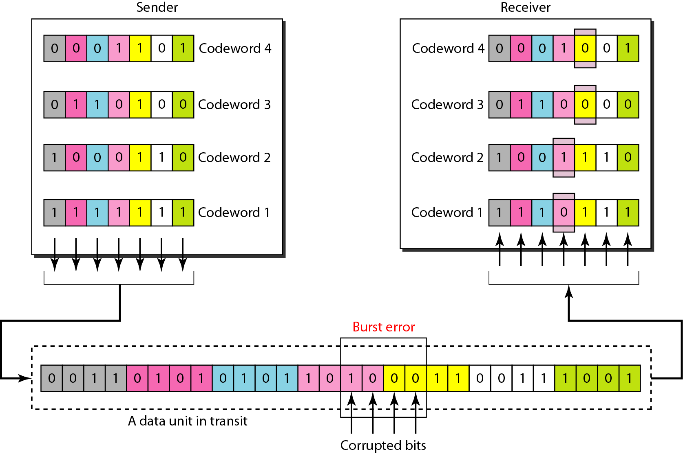
Figure 10.13 Burst error correction using Hamming code

Slide 52
10-4 CYCLIC CODES
Cyclic codes are special linear block codes with one extra property. In a cyclic code, if a codeword is cyclically shifted (rotated), the result is another codeword.
Topics discussed in this section:
Cyclic Redundancy Check Hardware Implementation Polynomials Cyclic Code Analysis
Advantages of Cyclic Codes Other Cyclic Codes

Slide 53
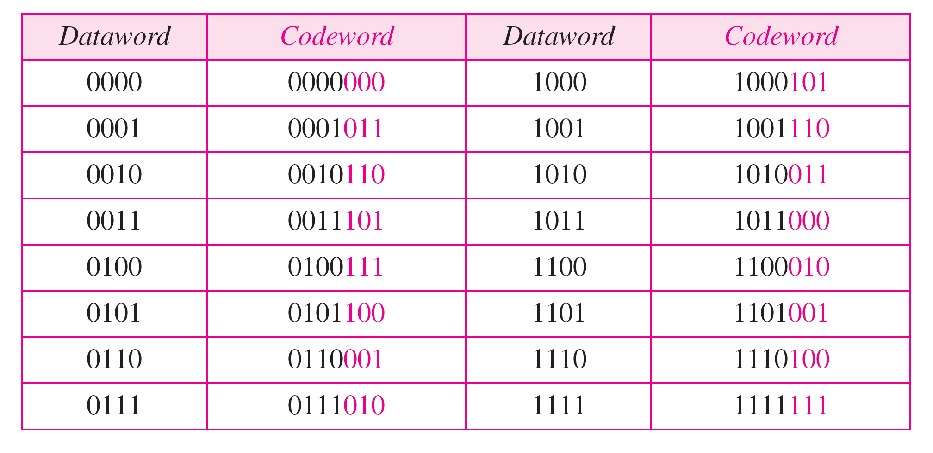
Table 10.6 A CRC code with C(7, 4)

Slide 54
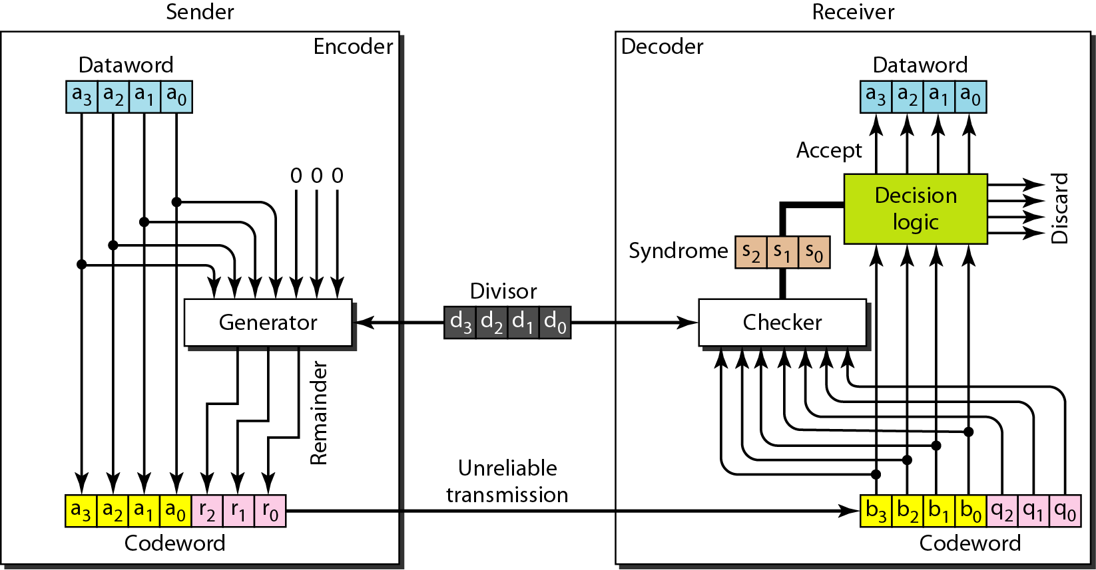
Figure 10.14 CRC encoder and decoder

Slide 55
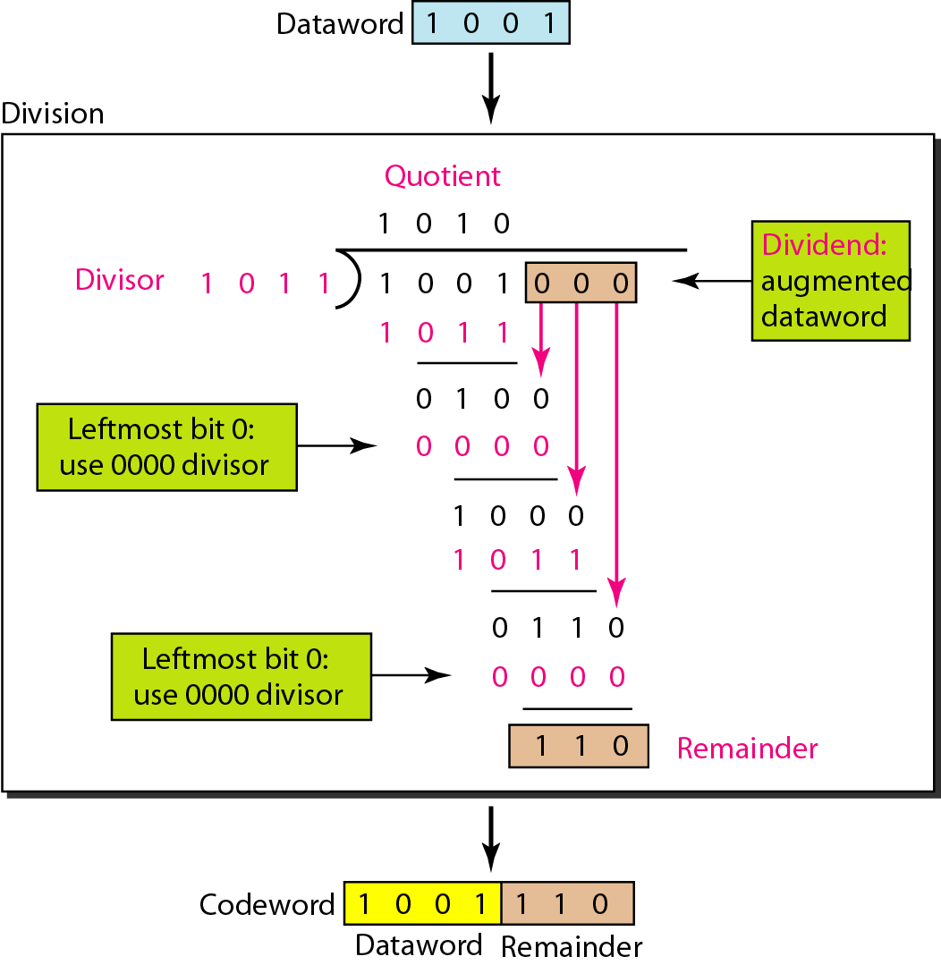
Figure 10.15 Division in CRC encoder

Slide 56
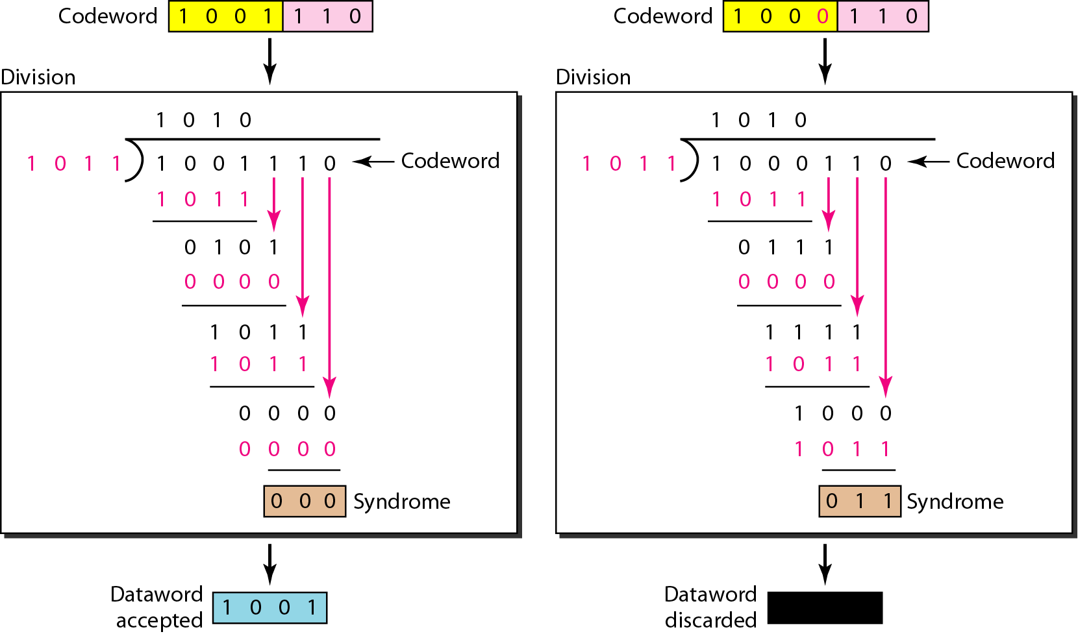
Figure 10.16 Division in the CRC decoder for two cases

Slide 57
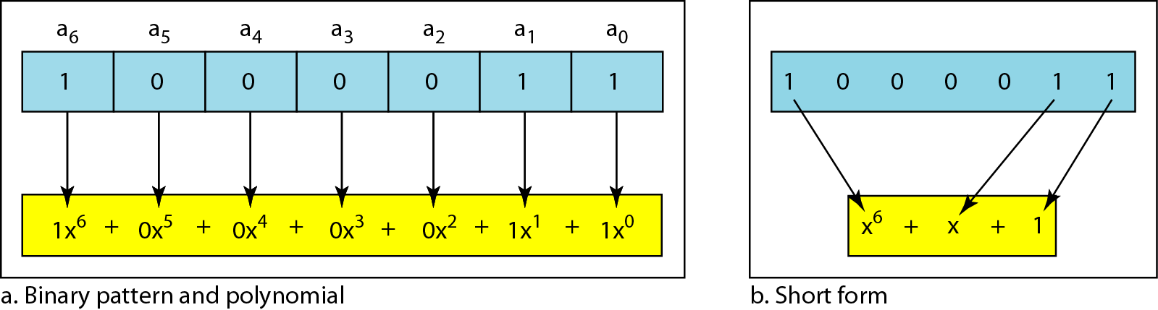
Figure 10.21 A polynomial to represent a binary word

Slide 58
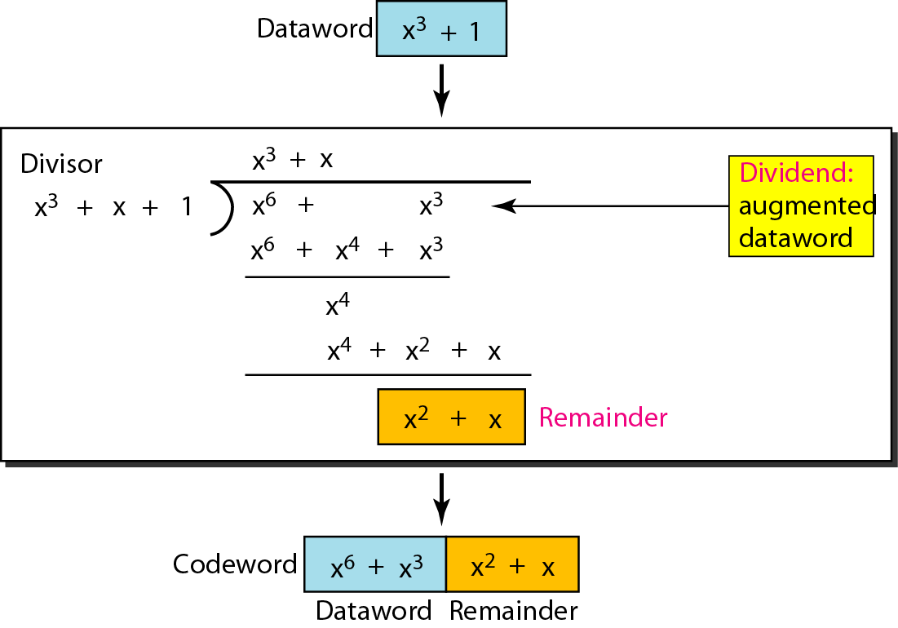
Figure 10.22 CRC division using polynomials

Slide 59
Note
The divisor in a cyclic code is normally called the generator polynomial
or simply the generator.

Slide 60
Note
In a cyclic code, those e(x) errors that are divisible by g(x) are not caught.

Slide 61
Note
If the generator has more than one term and the coefficient of x⁰ is 1, all single errors can be caught.

Slide 62
Table 10.7 Standard polynomials

Slide 63
10-5 CHECKSUM
The last error detection method we discuss here is called the checksum. The checksum is used in the Internet by several protocols although not at the data link layer. However, we briefly discuss it here to complete our discussion on error checking
Topics discussed in this section:
Idea One’s Complement

Slide 64
Example 10.18
Suppose our data is a list of five 4-bit numbers that we want to send to a destination. In addition to sending these numbers, we send the sum of the numbers. For example, if the set of numbers is (7, 11, 12, 0, 6), we send (7, 11, 12, 0, 6, 36), where 36 is the sum of the original numbers. The receiver adds the five numbers and compares the result with the sum. If the two are the same, the receiver assumes no error, accepts the five numbers, and discards the sum. Otherwise, there is an error somewhere and the data are not accepted.

Slide 65
Example 10.19
We can make the job of the receiver easier if we send the negative (complement) of the sum, called the checksum. In this case, we send (7, 11, 12, 0, 6, −36). The receiver can add all the numbers received (including the checksum). If the result is 0, it assumes no error; otherwise, there is an error.

Slide 66
Example 10.20
How can we represent the number 21 in one’s complement arithmetic using only four bits?
Solution
The number 21 in binary is 10101 (it needs five bits). We can wrap the leftmost bit and add it to the four rightmost bits. We have (0101 + 1) = 0110 or 6.

Slide 67
Example 10.21
How can we represent the number −6 in one’s complement arithmetic using only four bits?
Solution
In one’s complement arithmetic, the negative or complement of a number is found by inverting all bits. Positive 6 is 0110; negative 6 is 1001. If we consider only unsigned numbers, this is 9. In other words, the complement of 6 is 9. Another way to find the complement of a number in one’s complement arithmetic is to subtract the number from 2^{n} − 1 (16 − 1 in this case).

Slide 68
Example 10.22
Let us redo Exercise 10.19 using one’s complement arithmetic. Figure 10.24 shows the process at the sender and at the receiver. The sender initializes the checksum to 0 and adds all data items and the checksum (the checksum is considered as one data item and is shown in color). The result is 36. However, 36 cannot be expressed in 4 bits. The extra two bits are wrapped and added with the sum to create the wrapped sum value 6. In the figure, we have shown the details in binary. The sum is then complemented, resulting in the checksum value 9 (15 − 6 = 9). The sender now sends six data items to the receiver including the checksum 9.

Slide 69
Example 10.22 (continued)
The receiver follows the same procedure as the sender. It adds all data items (including the checksum); the result is 45. The sum is wrapped and becomes 15. The wrapped sum is complemented and becomes 0. Since the value of the checksum is 0, this means that the data is not corrupted. The receiver drops the checksum and keeps the other data items. If the checksum is not zero, the entire packet is dropped.

Slide 70
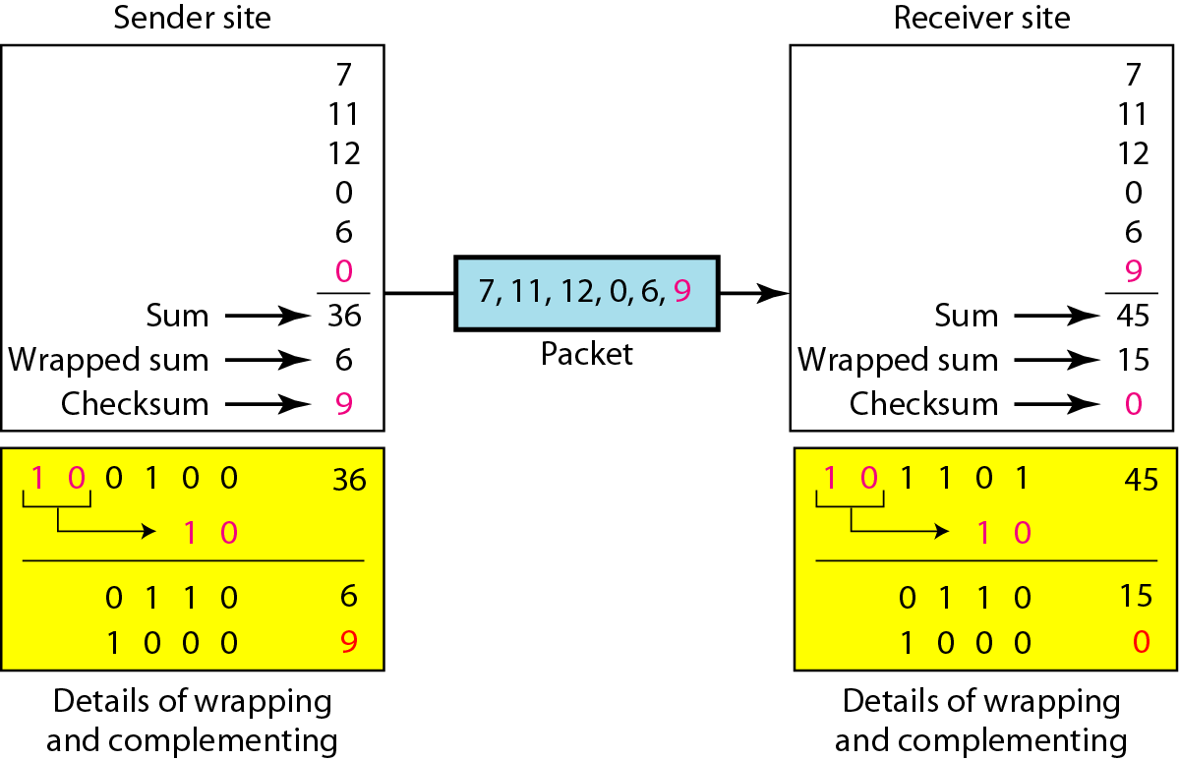
Figure 10.24 Example 10.22

Slide 71
Note
Sender site:
1. The message is divided into 16-bit words.
2. The value of the checksum word is set to 0.
3. All words including the checksum are added using one’s complement addition.
4. The sum is complemented and becomes the checksum.
5. The checksum is sent with the data.

Slide 72
Note
Receiver site:
1. The message (including checksum) is divided into 16-bit words.
2. All words are added using one’s complement addition.
3. The sum is complemented and becomes the new checksum.
4. If the value of checksum is 0, the message is accepted; otherwise, it is rejected.

Slide 73
Chapter 11
Data Link Control
Copyright © The McGraw-Hill Companies, Inc. Permission required for reproduction or display.

Slide 74
11-2 FLOW AND ERROR CONTROL
The most important responsibilities of the data link layer are flow control and error control. Collectively, these functions are known as data link control.
Topics discussed in this section:
Flow Control Error Control

Slide 75
Note
Flow control refers to a set of procedures used to restrict the amount of data
that the sender can send before
waiting for acknowledgment.

Slide 76
Note
Error control in the data link layer is based on automatic repeat request, which is the retransmission of data.

Slide 77
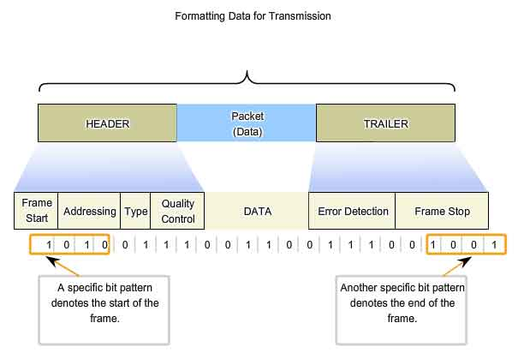

Slide 78
11-3 PROTOCOLS
Now let us see how the data link layer can combine framing, flow control, and error control to achieve the delivery of data from one node to another. The protocols are normally implemented in software by using one of the common programming languages. To make our discussions language-free, we have written in pseudocode a version of each protocol that concentrates mostly on the procedure instead of delving into the details of language rules.

Slide 79
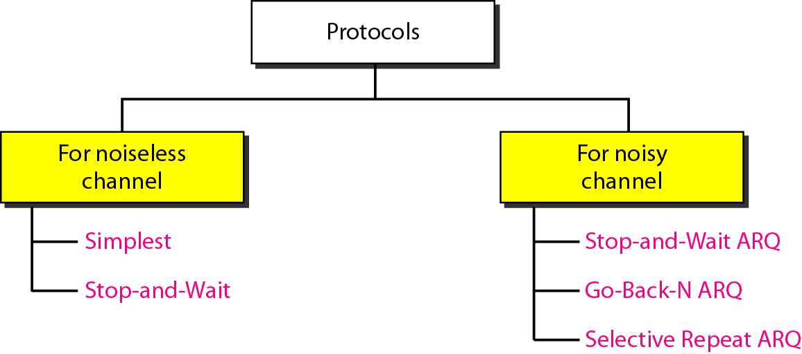
Figure 11.5 Taxonomy of protocols discussed in this chapter

Slide 80
11-4 NOISELESS CHANNELS
Let us first assume we have an ideal channel in which no frames are lost, duplicated, or corrupted. We introduce two protocols for this type of channel.
Topics discussed in this section:
Simplest Protocol Stop-and-Wait Protocol

Slide 81
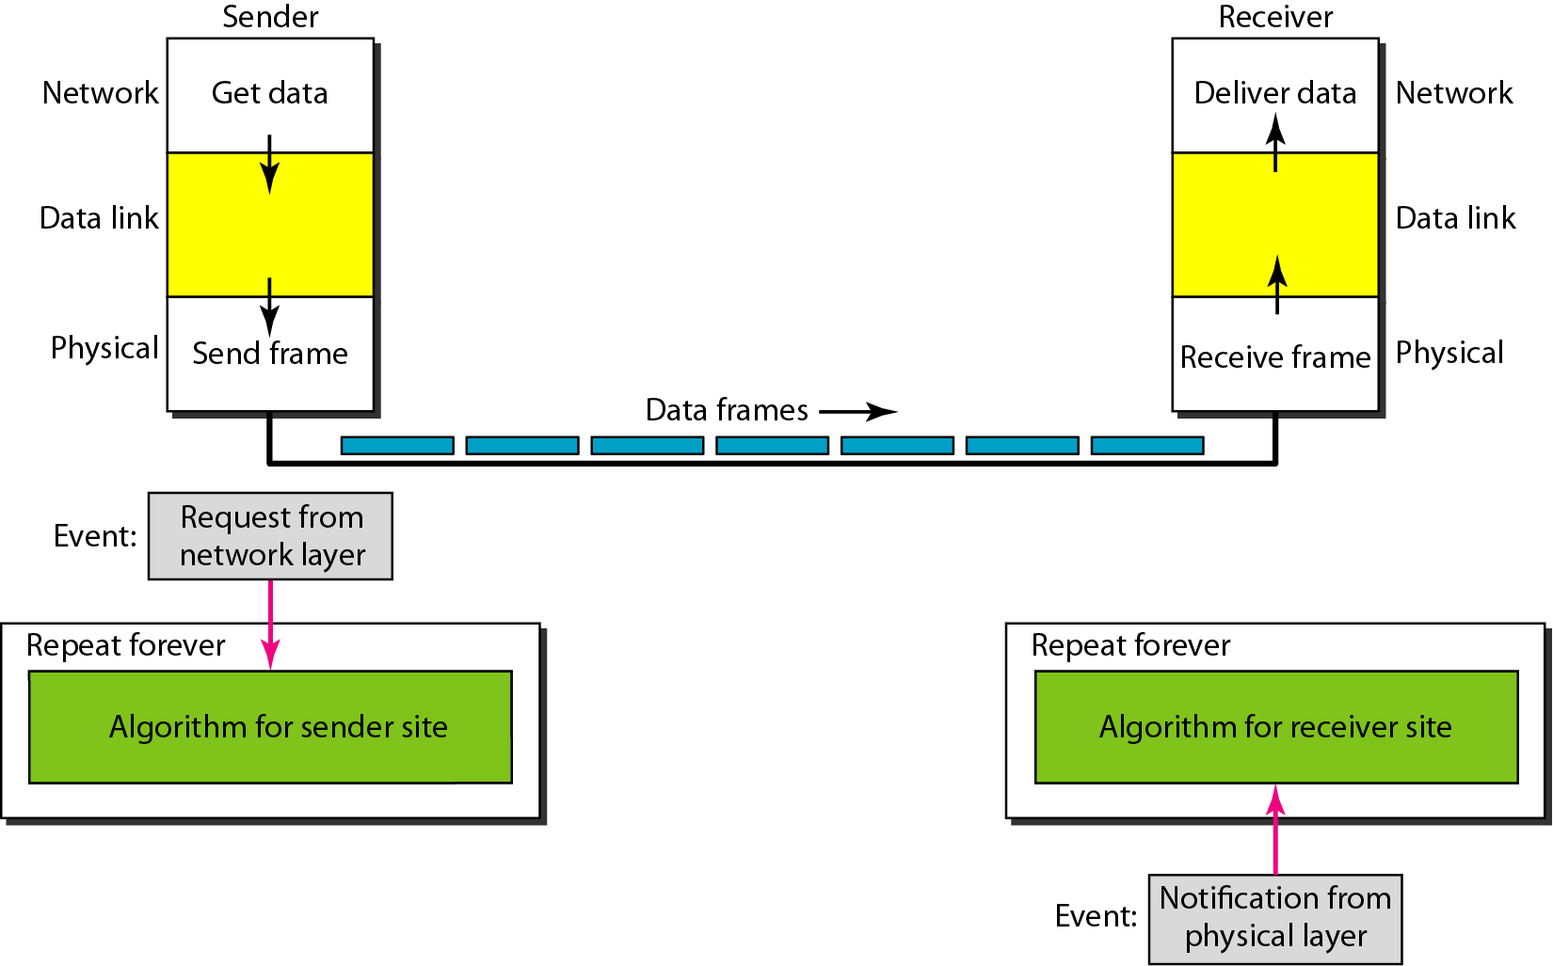
Figure 11.6 The design of the simplest protocol with no flow or error control

Slide 82
Algorithm 11.1 Sender-site algorithm for the simplest protocol

Slide 83
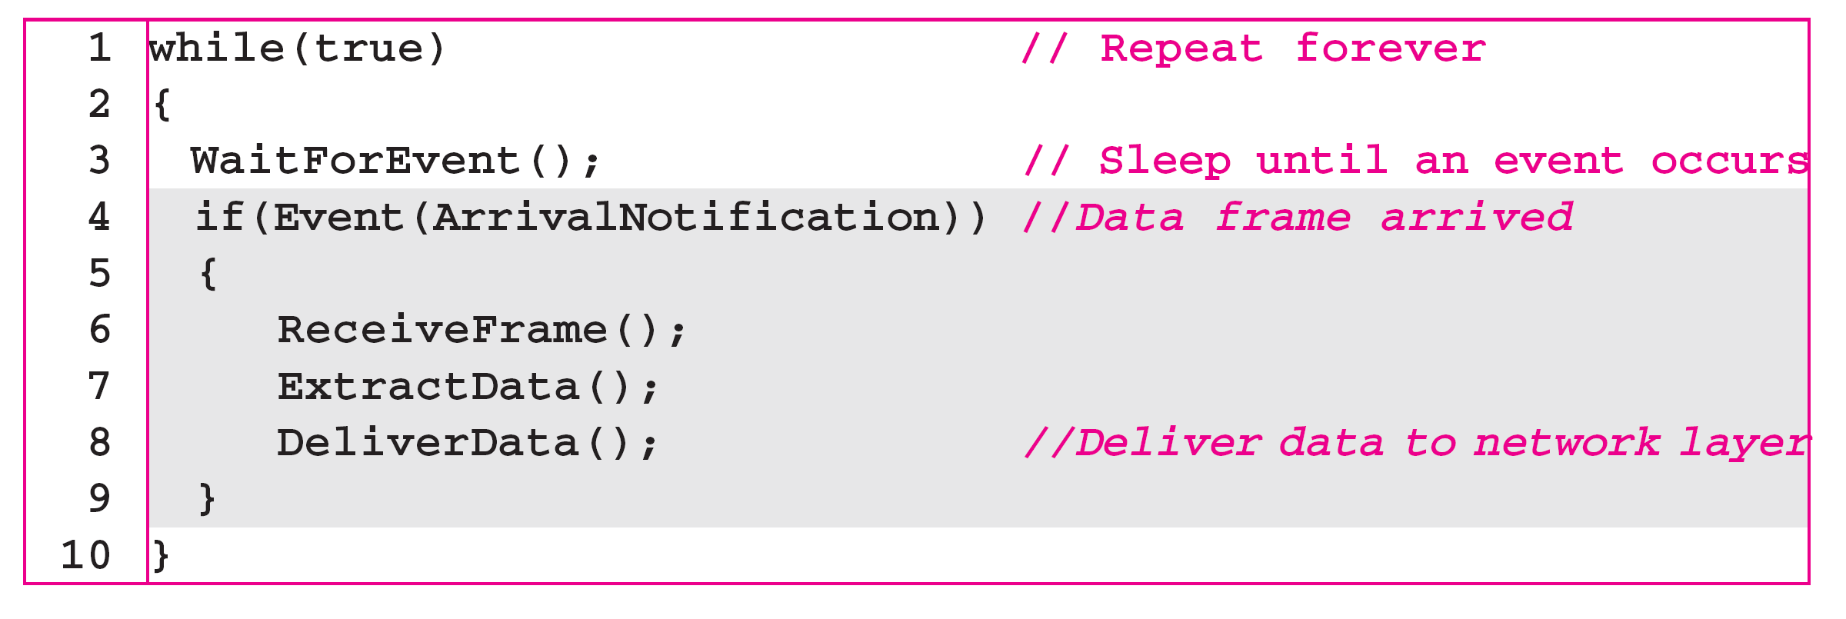
Algorithm 11.2 Receiver-site algorithm for the simplest protocol

Slide 84
Example 11.1
Figure 11.7 shows an example of communication using this protocol. It is very simple. The sender sends a sequence of frames without even thinking about the receiver. To send three frames, three events occur at the sender site and three events at the receiver site. Note that the data frames are shown by tilted boxes; the height of the box defines the transmission time difference between
the first bit and the last bit in the frame.

Slide 85
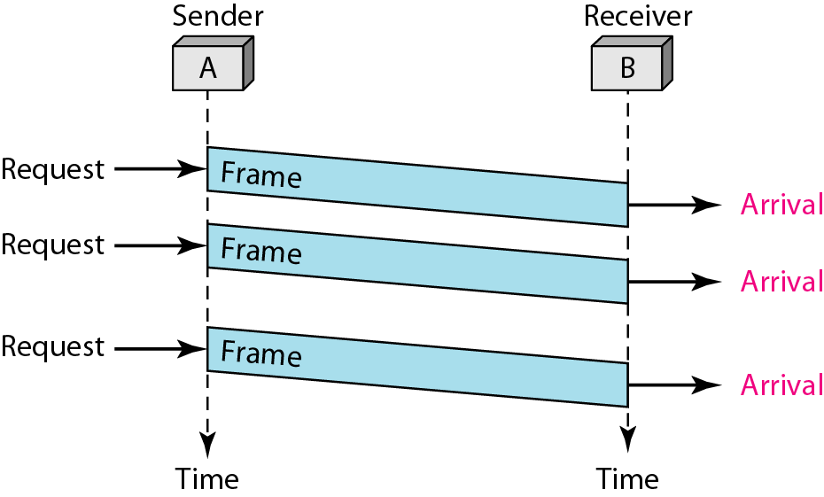
Figure 11.7 Flow diagram for Example 11.1

Slide 86
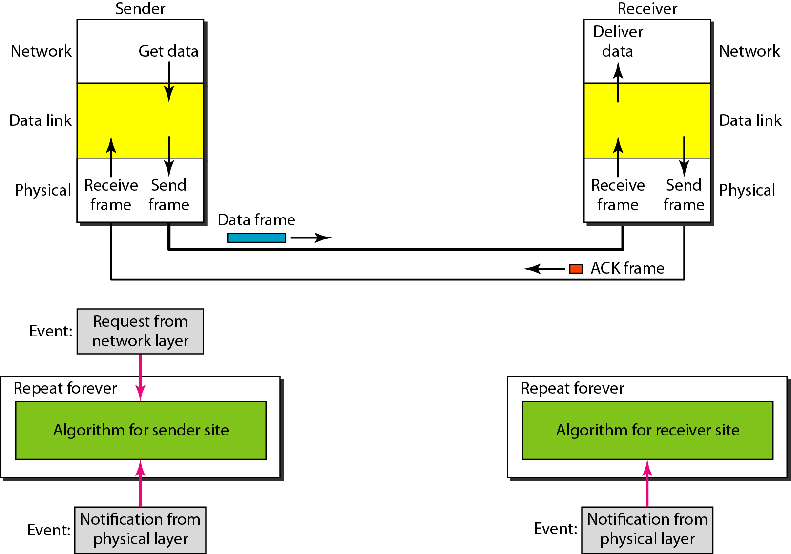
Figure 11.8 Design of Stop-and-Wait Protocol

Slide 87
Algorithm 11.3 Sender-site algorithm for Stop-and-Wait Protocol

Slide 88
Algorithm 11.4 Receiver-site algorithm for Stop-and-Wait Protocol

Slide 89
Example 11.2
Figure 11.9 shows an example of communication using this protocol. It is still very simple. The sender sends one frame and waits for feedback from the receiver. When the ACK arrives, the sender sends the next frame. Note that sending two frames in the protocol involves the sender in four events and the receiver in two events.

Slide 90
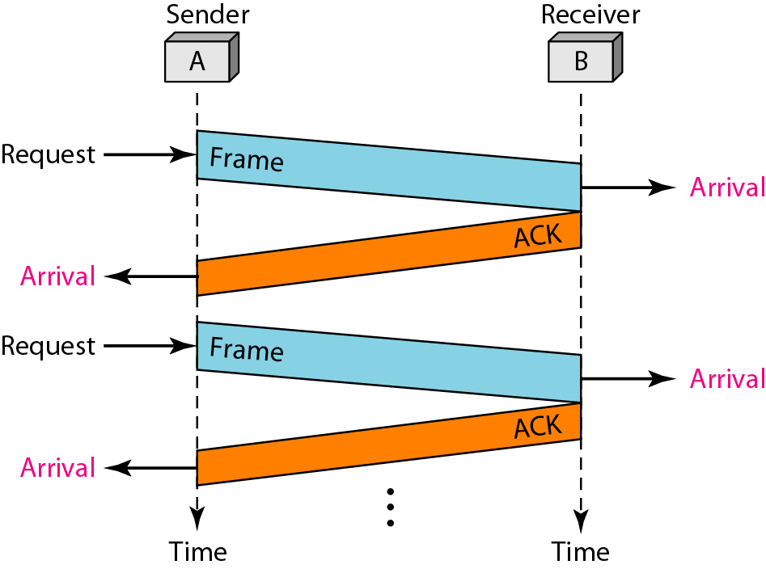
Figure 11.9 Flow diagram for Example 11.2

Slide 91
11-5 NOISY CHANNELS
Although the Stop-and-Wait Protocol gives us an idea of how to add flow control to its predecessor, noiseless channels are nonexistent. We discuss three protocols in this section that use error control.
Topics discussed in this section:
Stop-and-Wait Automatic Repeat Request Go-Back-N Automatic Repeat Request Selective Repeat Automatic Repeat Request

Slide 92
Stop-and-Wait ARQ Protocol
OR One-bit Sliding Window Protocol
Error correction in Stop-and-Wait ARQ is done by keeping a copy of the sent frame and retransmitting of the frame when the timer expires.
In Stop-and-Wait ARQ, we use sequence numbers to number the frames.
The sequence numbers are based on modulo-2 arithmetic (0,1,0,1,…).
In Stop-and-Wait ARQ, the acknowledgment number always announces in modulo-2 arithmetic the sequence number of the next frame expected.

Slide 93
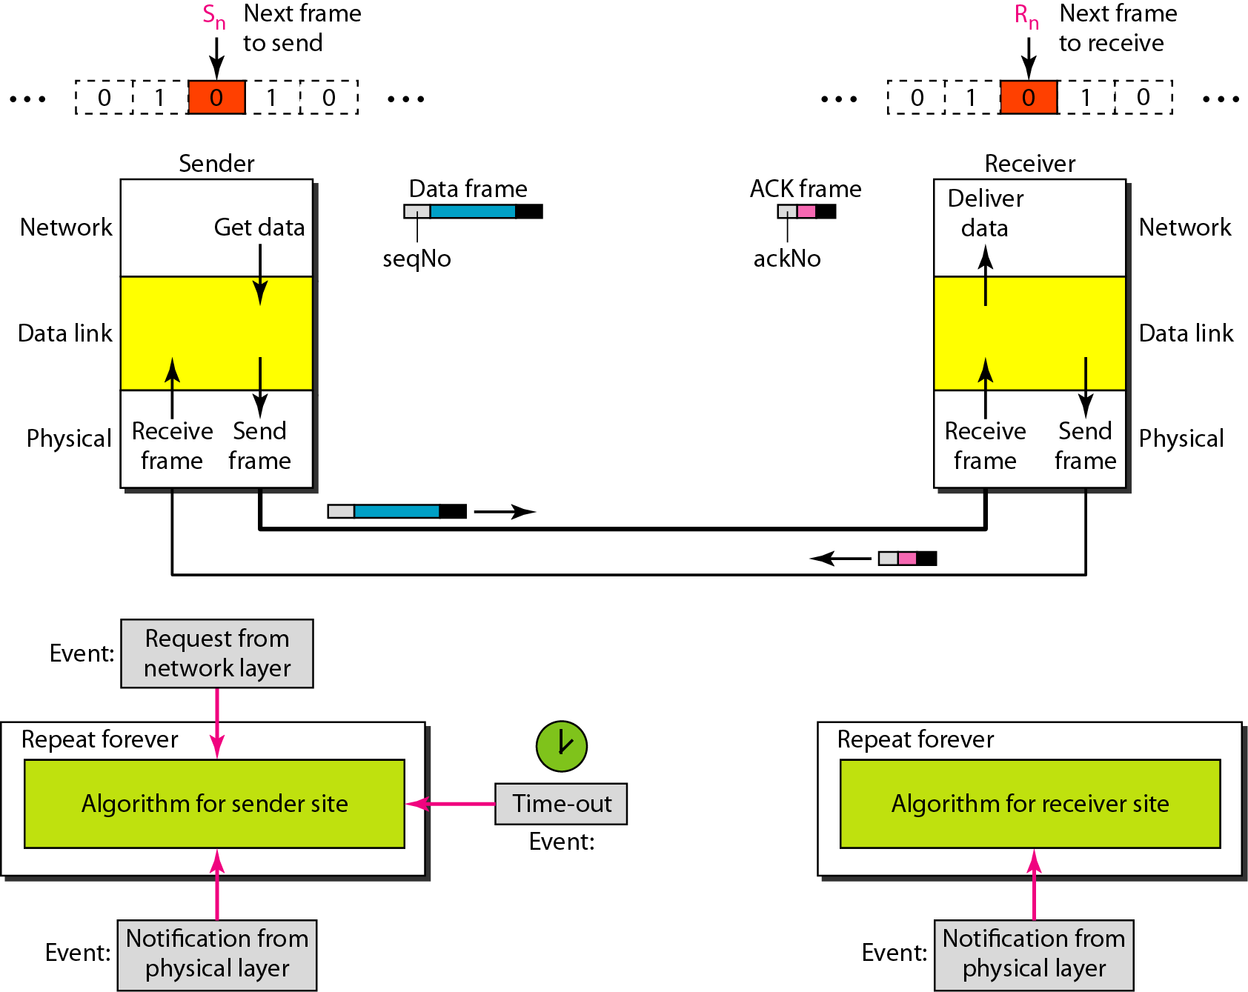
Figure 11.10 Design of the Stop-and-Wait ARQ Protocol

Slide 94
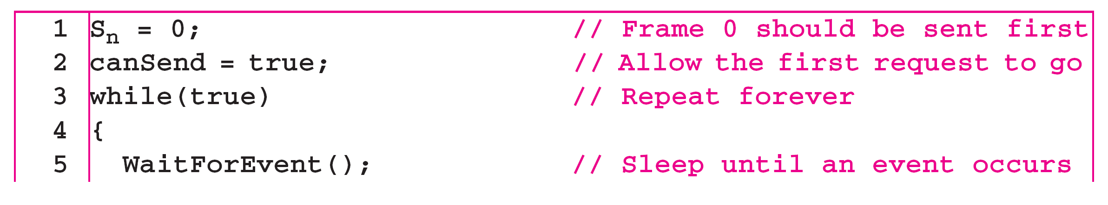
Algorithm 11.5 Sender-site algorithm for Stop-and-Wait ARQ
(continued)

Slide 95
Algorithm 11.5 Sender-site algorithm for Stop-and-Wait ARQ
(continued)

Slide 96
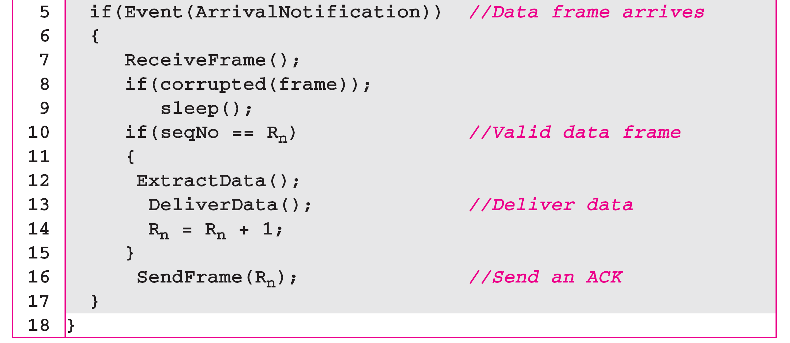
Algorithm 11.6 Receiver-site algorithm for Stop-and-Wait ARQ Protocol

Slide 97
Example 11.3
Figure 11.11 shows an example of Stop-and-Wait ARQ. Frame 0 is sent and acknowledged. Frame 1 is lost and resent after the time-out. The resent frame 1 is acknowledged and the timer stops. Frame 0 is sent and acknowledged, but the acknowledgment is lost. The sender has no idea if the frame or the acknowledgment is lost, so after the time-out, it resends frame 0, which is acknowledged.

Slide 98
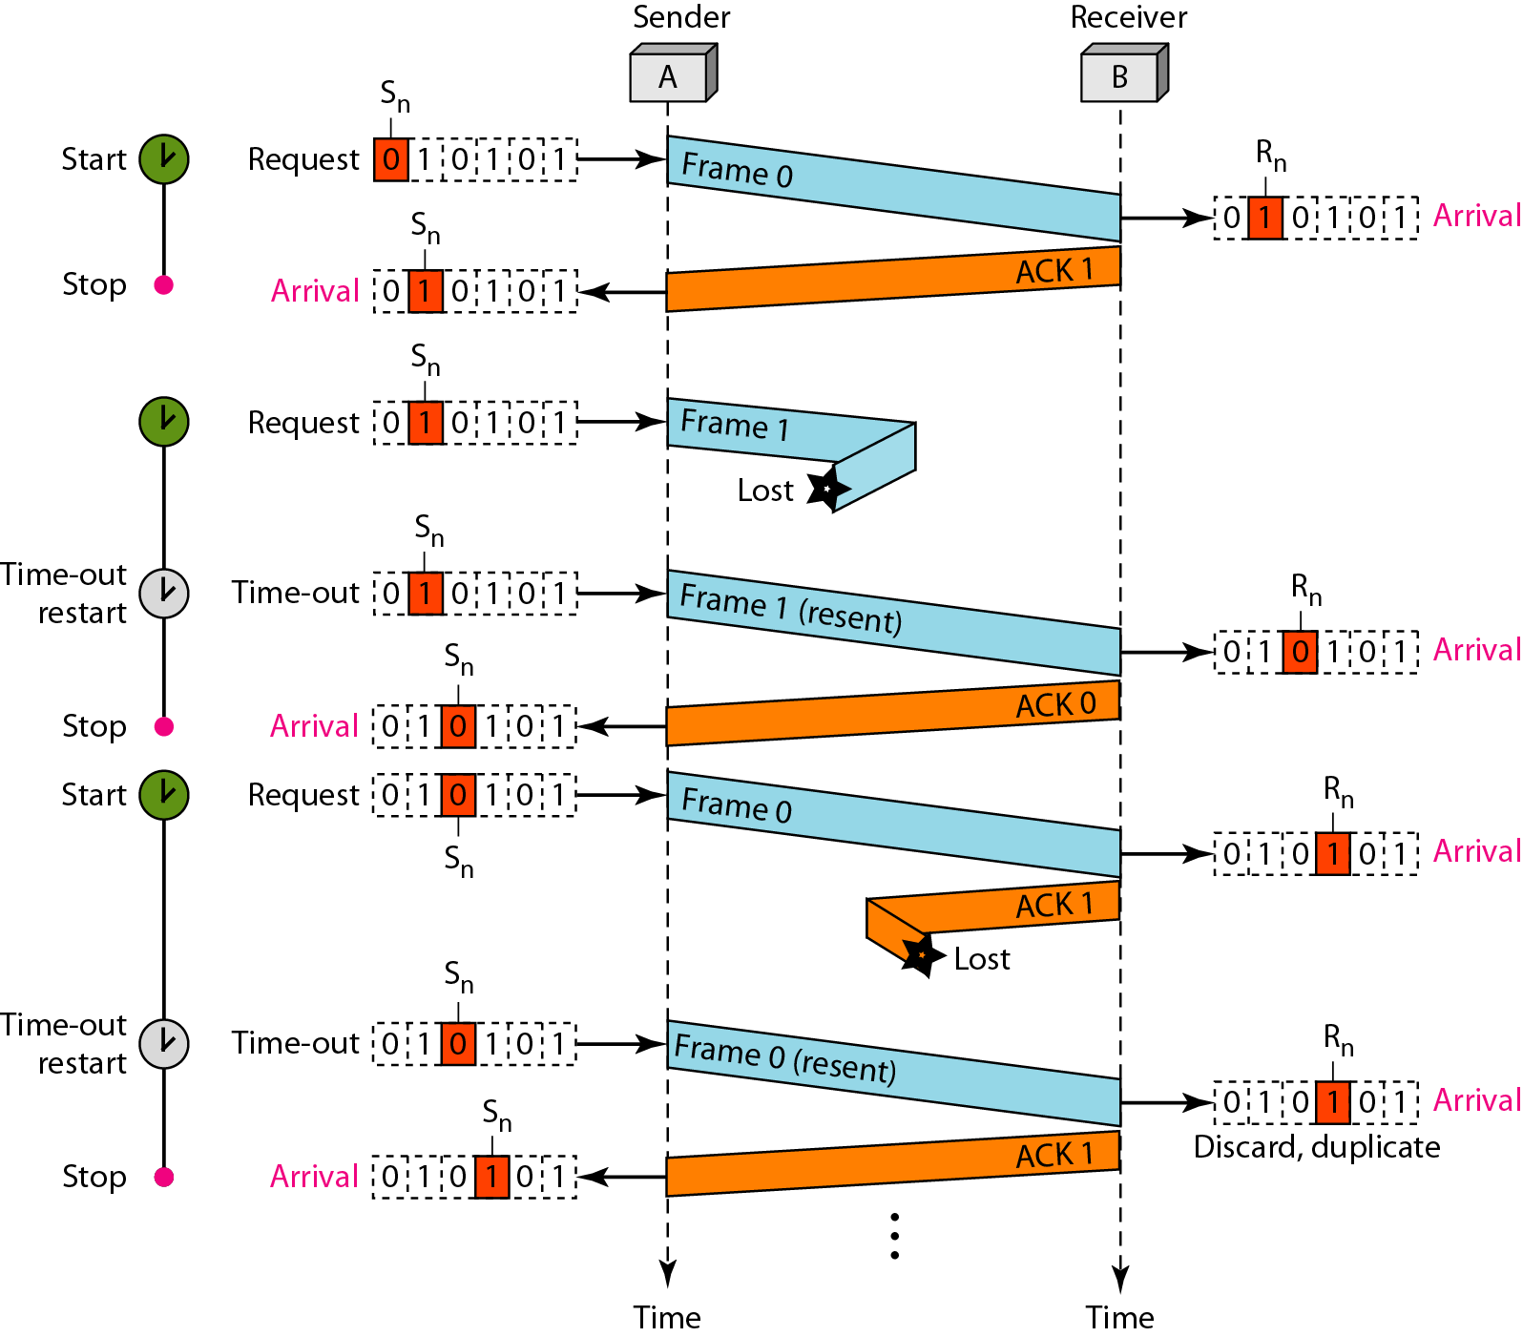
Figure 11.11 Flow diagram for Example 11.3

Slide 99
Example 11.4
Assume that, in a Stop-and-Wait ARQ system, the bandwidth of the line is 1 Mbps, and 1 bit takes 20 ms to make a round trip. What is the bandwidth-delay product? If the system data frames are 1000 bits in length, what is the utilization percentage of the link?
Solution
The bandwidth-delay product is

Slide 100
Example 11.4 (continued)
The system can send 20,000 bits during the time it takes for the data to go from the sender to the receiver and then back again. However, the system sends only 1000 bits. We can say that the link utilization is only 1000/20,000, or 5 percent. For this reason, for a link with a high bandwidth or long delay, the use of Stop-and-Wait ARQ wastes the capacity of the link.

Slide 101
Example 11.5
What is the utilization percentage of the link in Example 11.4 if we have a protocol that can send up to 15 frames before stopping and worrying about the acknowledgments?
Solution
The bandwidth-delay product is still 20,000 bits. The system can send up to 15 frames or 15,000 bits during a round trip. This means the utilization is 15,000/20,000, or 75 percent. Of course, if there are damaged frames, the utilization percentage is much less because frames have to be resent.

Slide 102
Go-Back-N Protocol
In the Go-Back-N Protocol, the sequence numbers are modulo 2^{m}, where m is the size of the sequence number field in bits.
The send window is an abstract concept defining an imaginary box of size 2^{m} − 1 with three variables: Sf, Sn, and S_{size}.
The send window can slide one or more slots when a valid acknowledgment arrives.
The receive window is an abstract concept defining an imaginary box of size 1 with one single variable Rn. The window slides when a correct frame has arrived; sliding occurs one slot at a time.

Slide 103
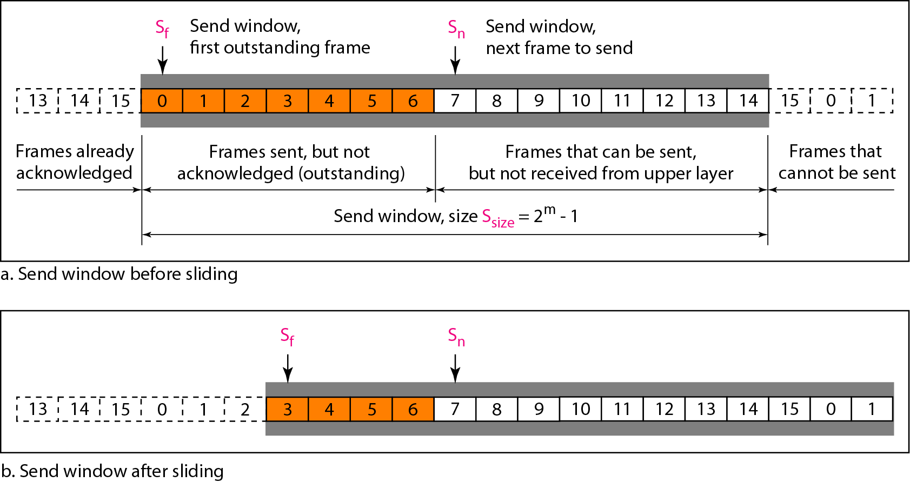
Figure 11.12 Send window for Go-Back-N ARQ

Slide 104
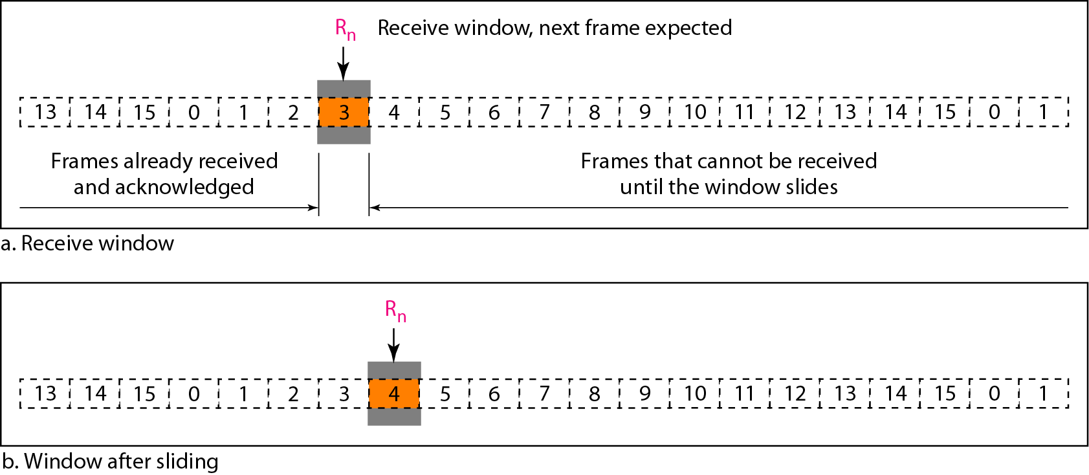
Figure 11.13 Receive window for Go-Back-N ARQ

Slide 105
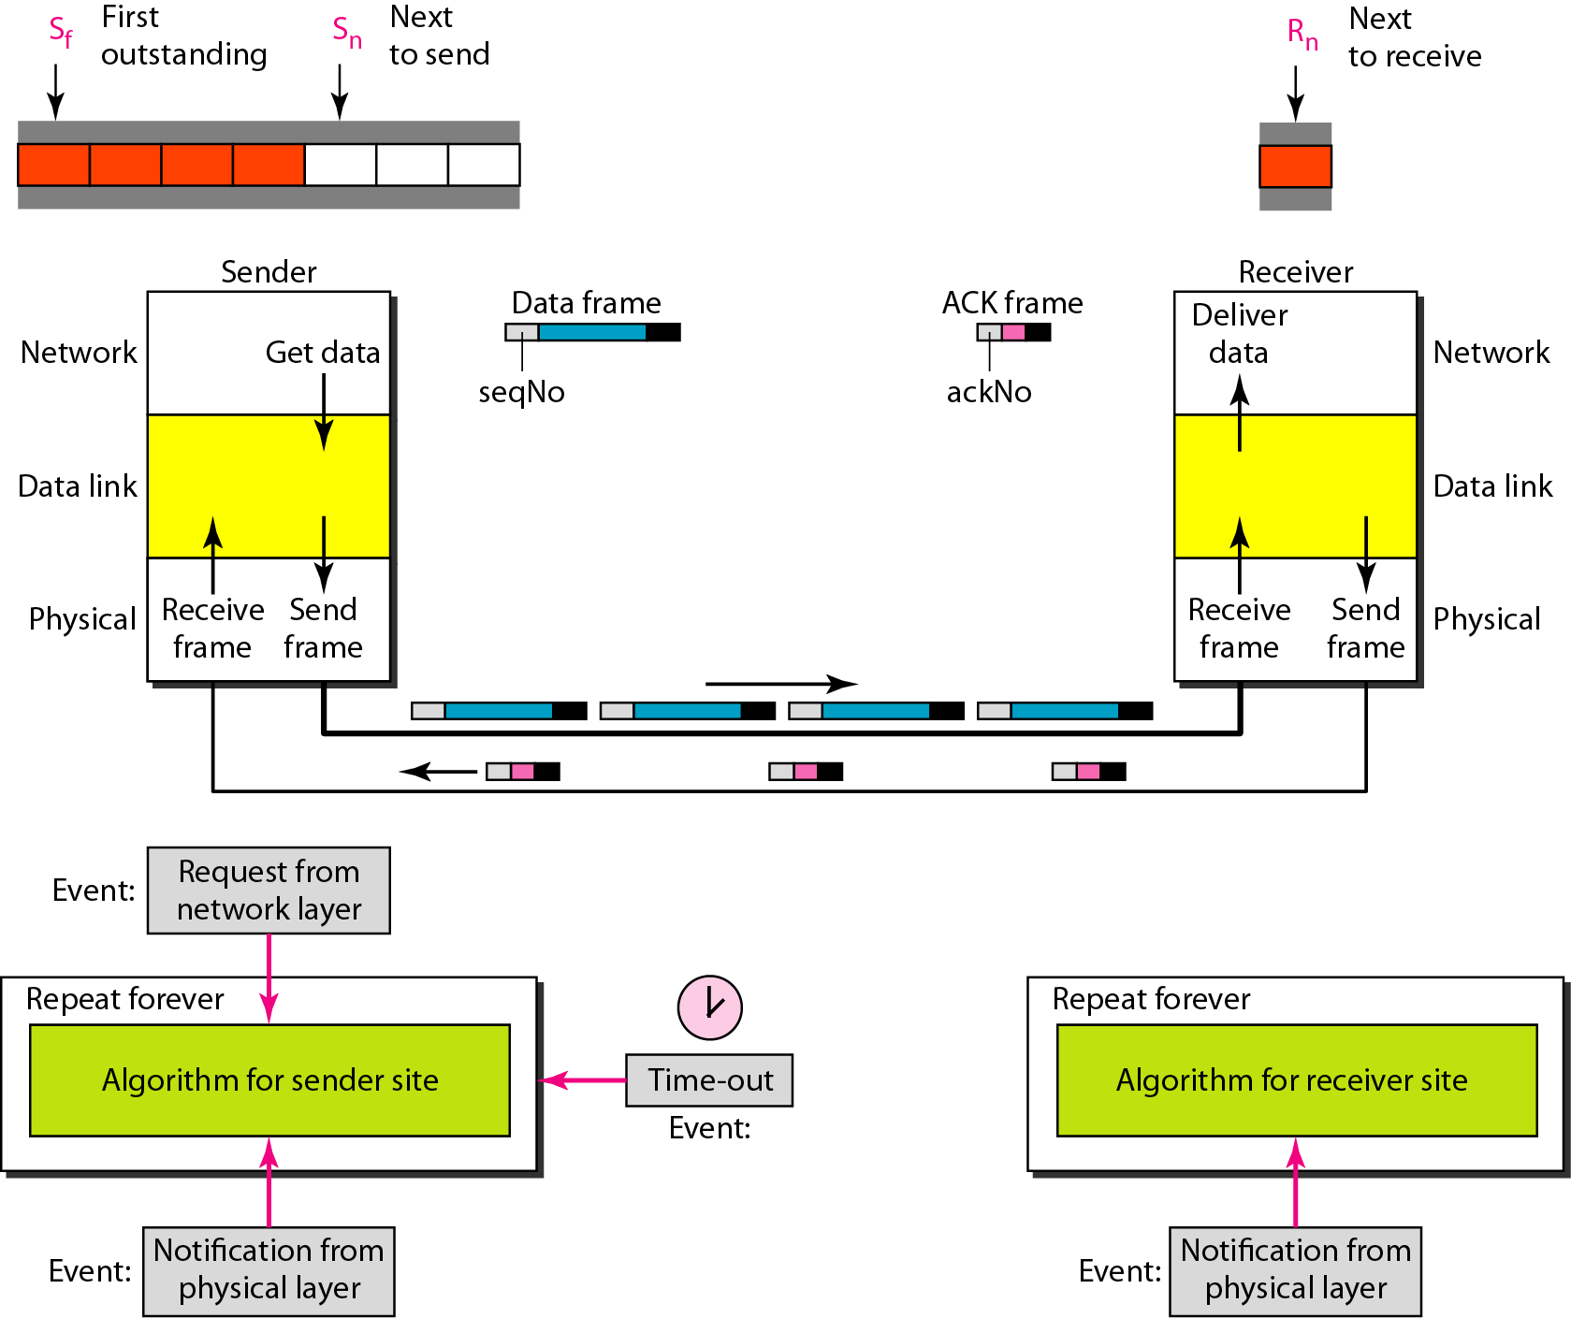
Figure 11.14 Design of Go-Back-N ARQ

Slide 106
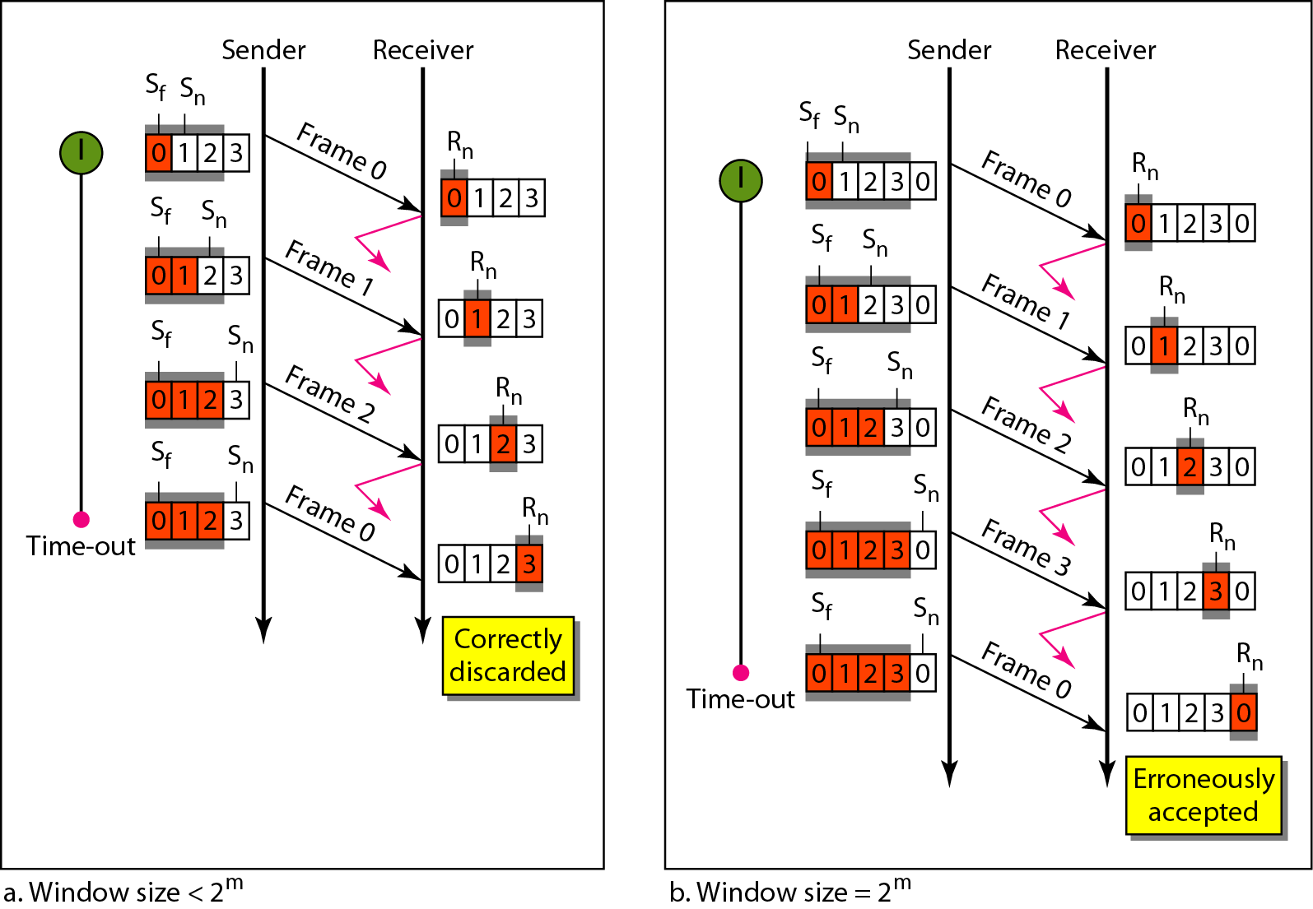
Figure 11.15 Window size for Go-Back-N ARQ

Slide 107
Note
In Go-Back-N ARQ, the size of the send window must be less than 2^{m};
the size of the receiver window is always 1.

Slide 108
Algorithm 11.7 Go-Back-N sender algorithm
(continued)

Slide 109
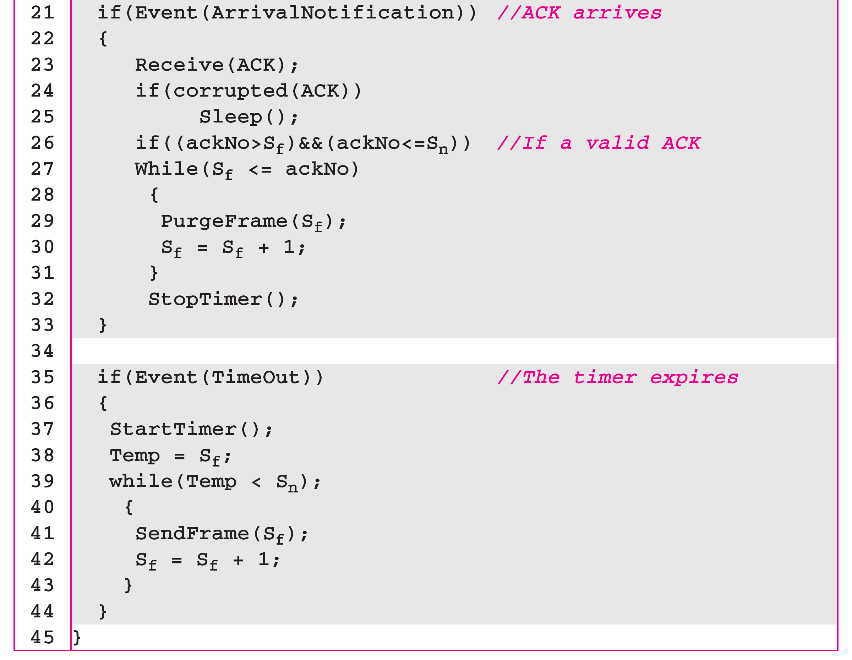
Algorithm 11.7 Go-Back-N sender algorithm
(continued)

Slide 110
Algorithm 11.8 Go-Back-N receiver algorithm

Slide 111
Example 11.6
Figure 11.16 shows an example of Go-Back-N. This is an example of a case where the forward channel is reliable, but the reverse is not. No data frames are lost, but some ACKs are delayed and one is lost. The example also shows how cumulative acknowledgments can help if acknowledgments are delayed or lost. After initialization, there are seven sender events. Request events are triggered by data from the network layer; arrival events are triggered by acknowledgments from the physical layer. There is no time-out event here because all outstanding frames are acknowledged before the timer expires. Note that although ACK 2 is lost, ACK 3 serves as both ACK 2 and ACK 3.

Slide 112
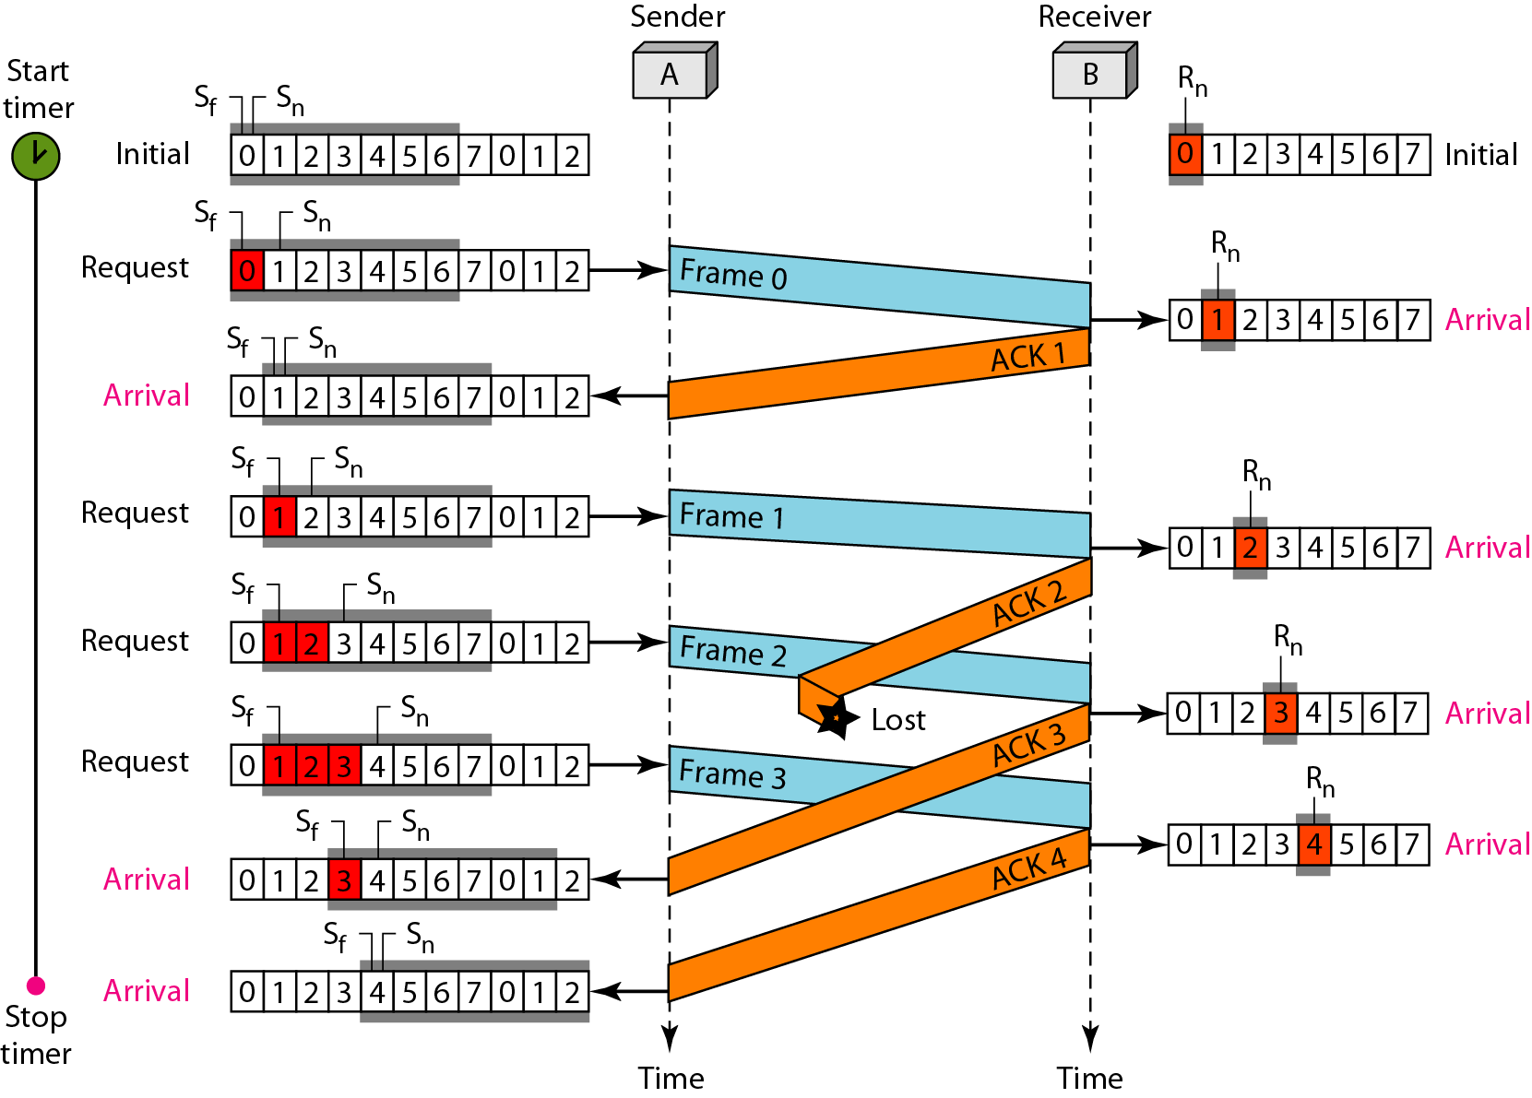
Figure 11.16 Flow diagram for Example 11.6

Slide 113
Example 11.7
Figure 11.17 shows what happens when a frame is lost. Frames 0, 1, 2, and 3 are sent. However, frame 1 is lost. The receiver receives frames 2 and 3, but they are discarded because they are received out of order. The sender receives no acknowledgment about frames 1, 2, or 3. Its timer finally expires. The sender sends all outstanding frames (1, 2, and 3) because it does not know what is wrong. Note that the resending of frames 1, 2, and 3 is the response to one single event. When the sender is responding to this event, it cannot accept the triggering of other events. This means that when ACK 2 arrives, the sender is still busy with sending frame 3.

Slide 114
Example 11.7 (continued)
The physical layer must wait until this event is completed and the data link layer goes back to its sleeping state. We have shown a vertical line to indicate the delay. It is the same story with ACK 3; but when ACK 3 arrives, the sender is busy responding to ACK 2. It happens again when ACK 4 arrives. Note that before the second timer expires, all outstanding frames have been sent and the timer is stopped.

Slide 115
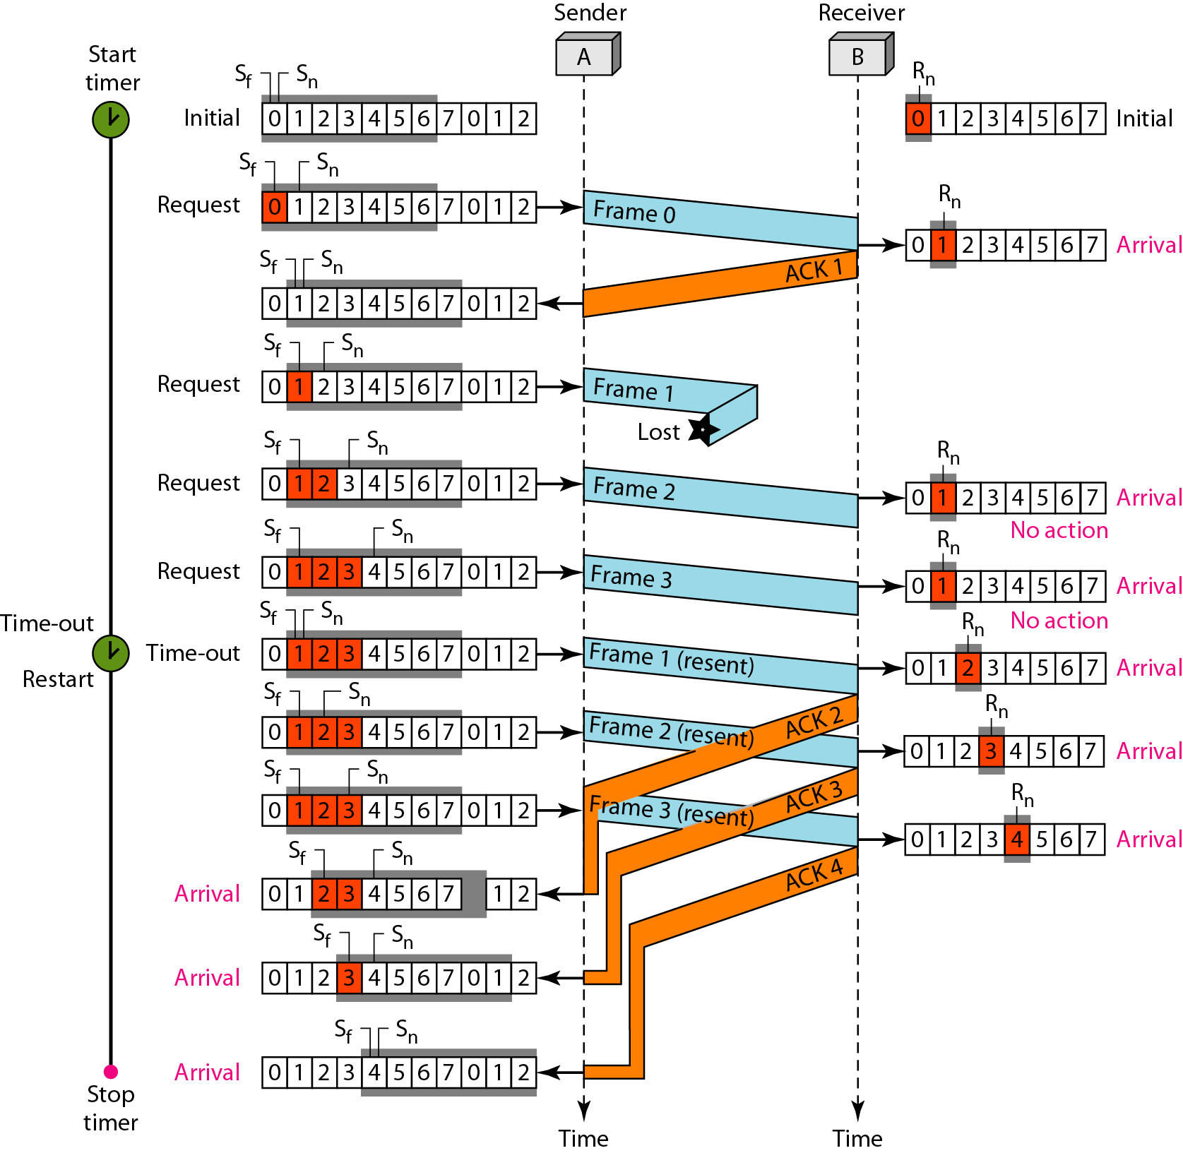
Figure 11.17 Flow diagram for Example 11.7

Slide 116
Note
Stop-and-Wait ARQ is a special case of Go-Back-N ARQ in which the size of the send window is 1.

Slide 117
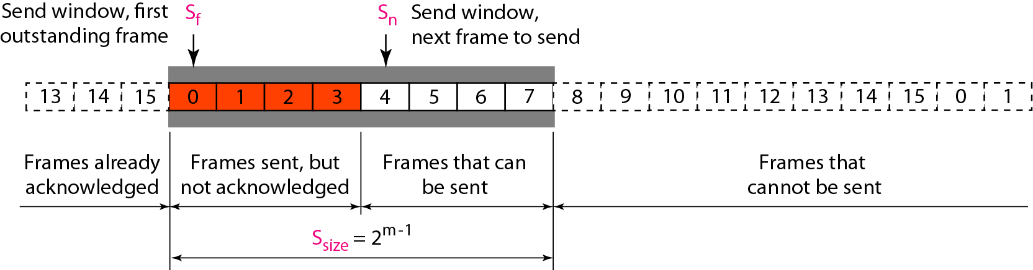
Figure 11.18 Send window for Selective Repeat ARQ

Slide 118
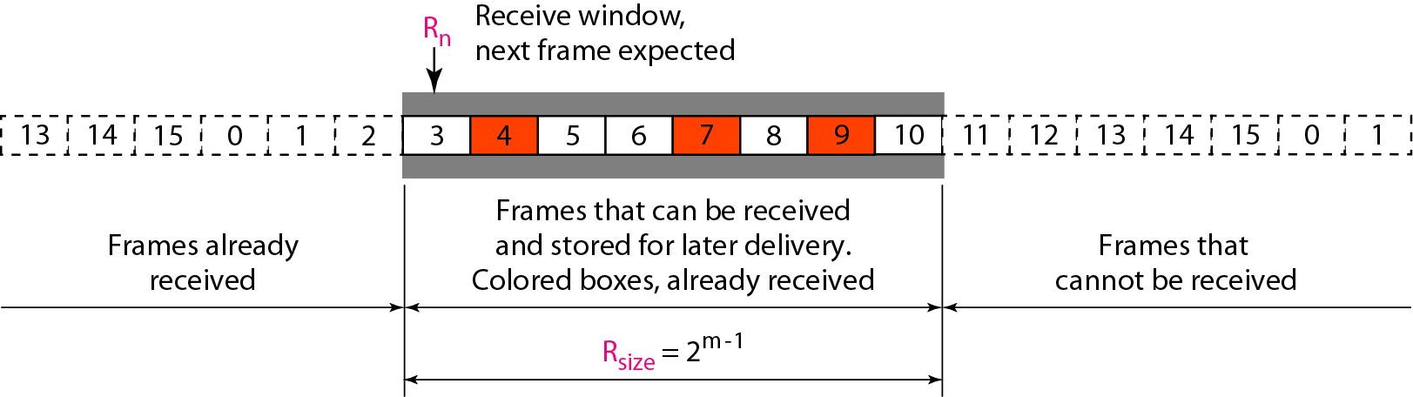
Figure 11.19 Receive window for Selective Repeat ARQ

Slide 119
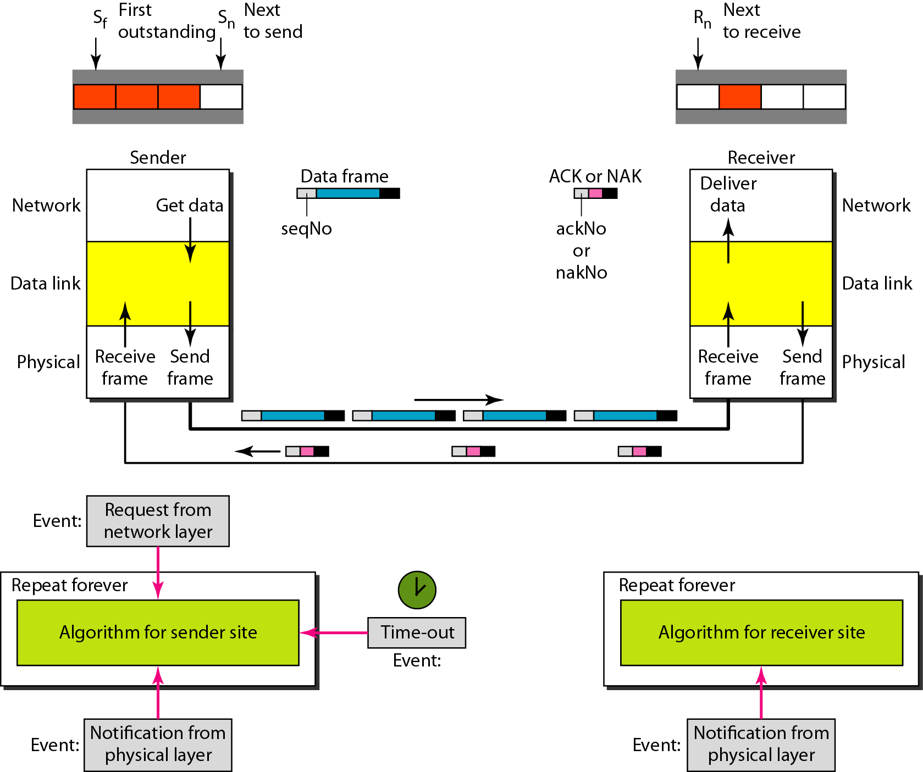
Figure 11.20 Design of Selective Repeat ARQ

Slide 120
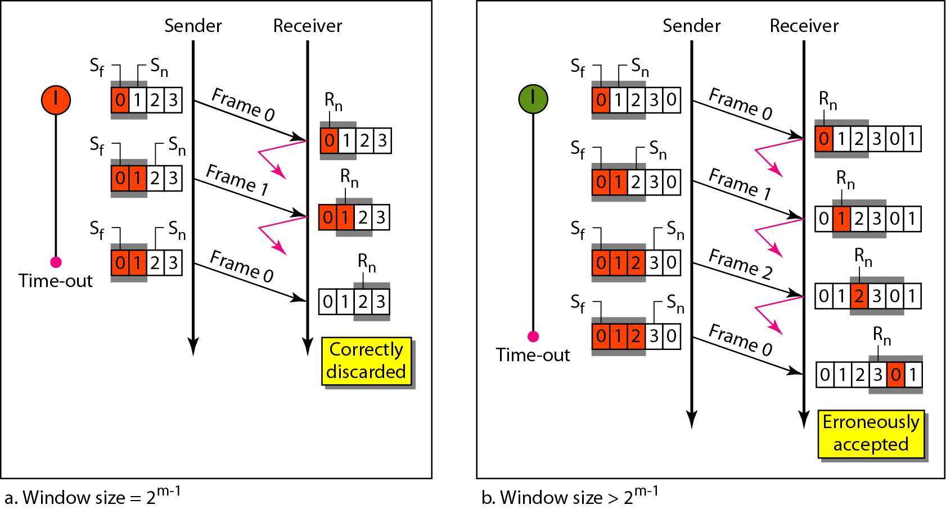
Figure 11.21 Selective Repeat ARQ, window size

Slide 121
Note
In Selective Repeat ARQ, the size of the sender and receiver window
must be at most one-half of 2^{m}.

Slide 122
Algorithm 11.9 Sender-site Selective Repeat algorithm
(continued)

Slide 123
Algorithm 11.9 Sender-site Selective Repeat algorithm
(continued)
(continued)

Slide 124
Algorithm 11.9 Sender-site Selective Repeat algorithm
(continued)

Slide 125
Algorithm 11.10 Receiver-site Selective Repeat algorithm

Slide 126
Algorithm 11.10 Receiver-site Selective Repeat algorithm

Slide 127
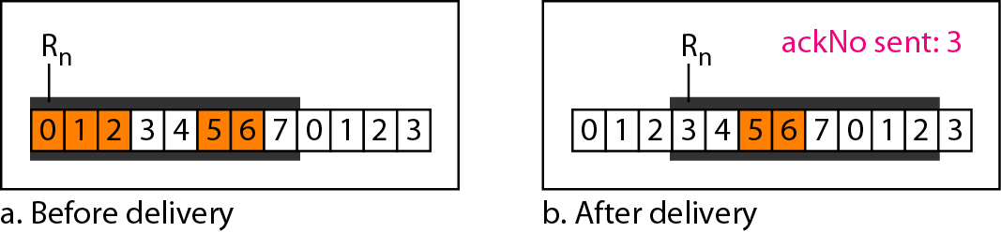
Figure 11.22 Delivery of data in Selective Repeat ARQ

Slide 128
Example 11.8
This example is similar to Example 11.3 in which frame 1 is lost. We show how Selective Repeat behaves in this case. Figure 11.23 shows the situation. One main difference is the number of timers. Here, each frame sent or resent needs a timer, which means that the timers need to be numbered (0, 1, 2, and 3). The timer for frame 0 starts at the first request, but stops when the ACK for this frame arrives. The timer for frame 1 starts at the second request, restarts when a NAK arrives, and finally stops when the last ACK arrives. The other two timers start when the corresponding frames are sent and stop at the last arrival event.

Slide 129
Example 11.8 (continued)
At the receiver site we need to distinguish between the acceptance of a frame and its delivery to the network layer. At the second arrival, frame 2 arrives and is stored and marked, but it cannot be delivered because frame 1 is missing. At the next arrival, frame 3 arrives and is marked and stored, but still none of the frames can be delivered. Only at the last arrival, when finally a copy of frame 1 arrives, can frames 1, 2, and 3 be delivered to the network layer. There are two conditions for the delivery of frames to the network layer: First, a set of consecutive frames must have arrived. Second, the set starts from the beginning of the window.

Slide 130
Example 11.8 (continued)
Another important point is that a NAK is sent after the second arrival, but not after the third, although both situations look the same. The reason is that the protocol does not want to crowd the network with unnecessary NAKs and unnecessary resent frames. The second NAK would still be NAK1 to inform the sender to resend frame 1 again; this has already been done. The first NAK sent is remembered (using the nakSent variable) and is not sent again until the frame slides. A NAK is sent once for each window position and defines the first slot in the window.

Slide 131
Example 11.8 (continued)
The next point is about the ACKs. Notice that only two ACKs are sent here. The first one acknowledges only the first frame; the second one acknowledges three frames. In Selective Repeat, ACKs are sent when data are delivered to the network layer. If the data belonging to n frames are delivered in one shot, only one ACK is sent for all of them.

Slide 132
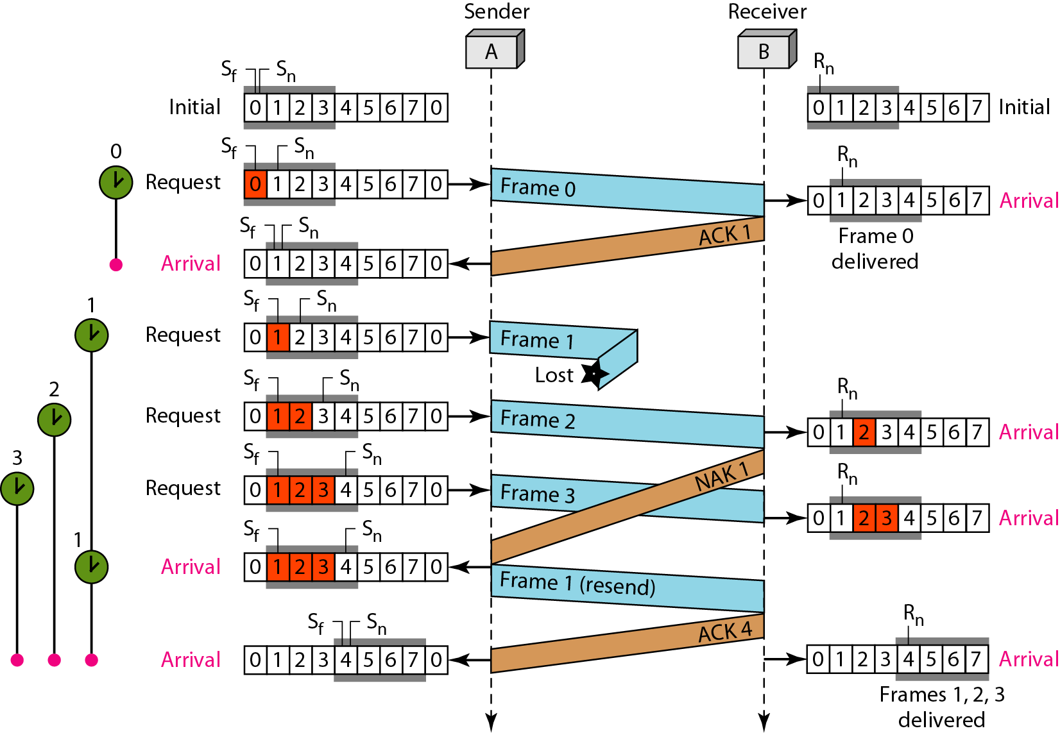
Figure 11.23 Flow diagram for Example 11.8

Slide 133
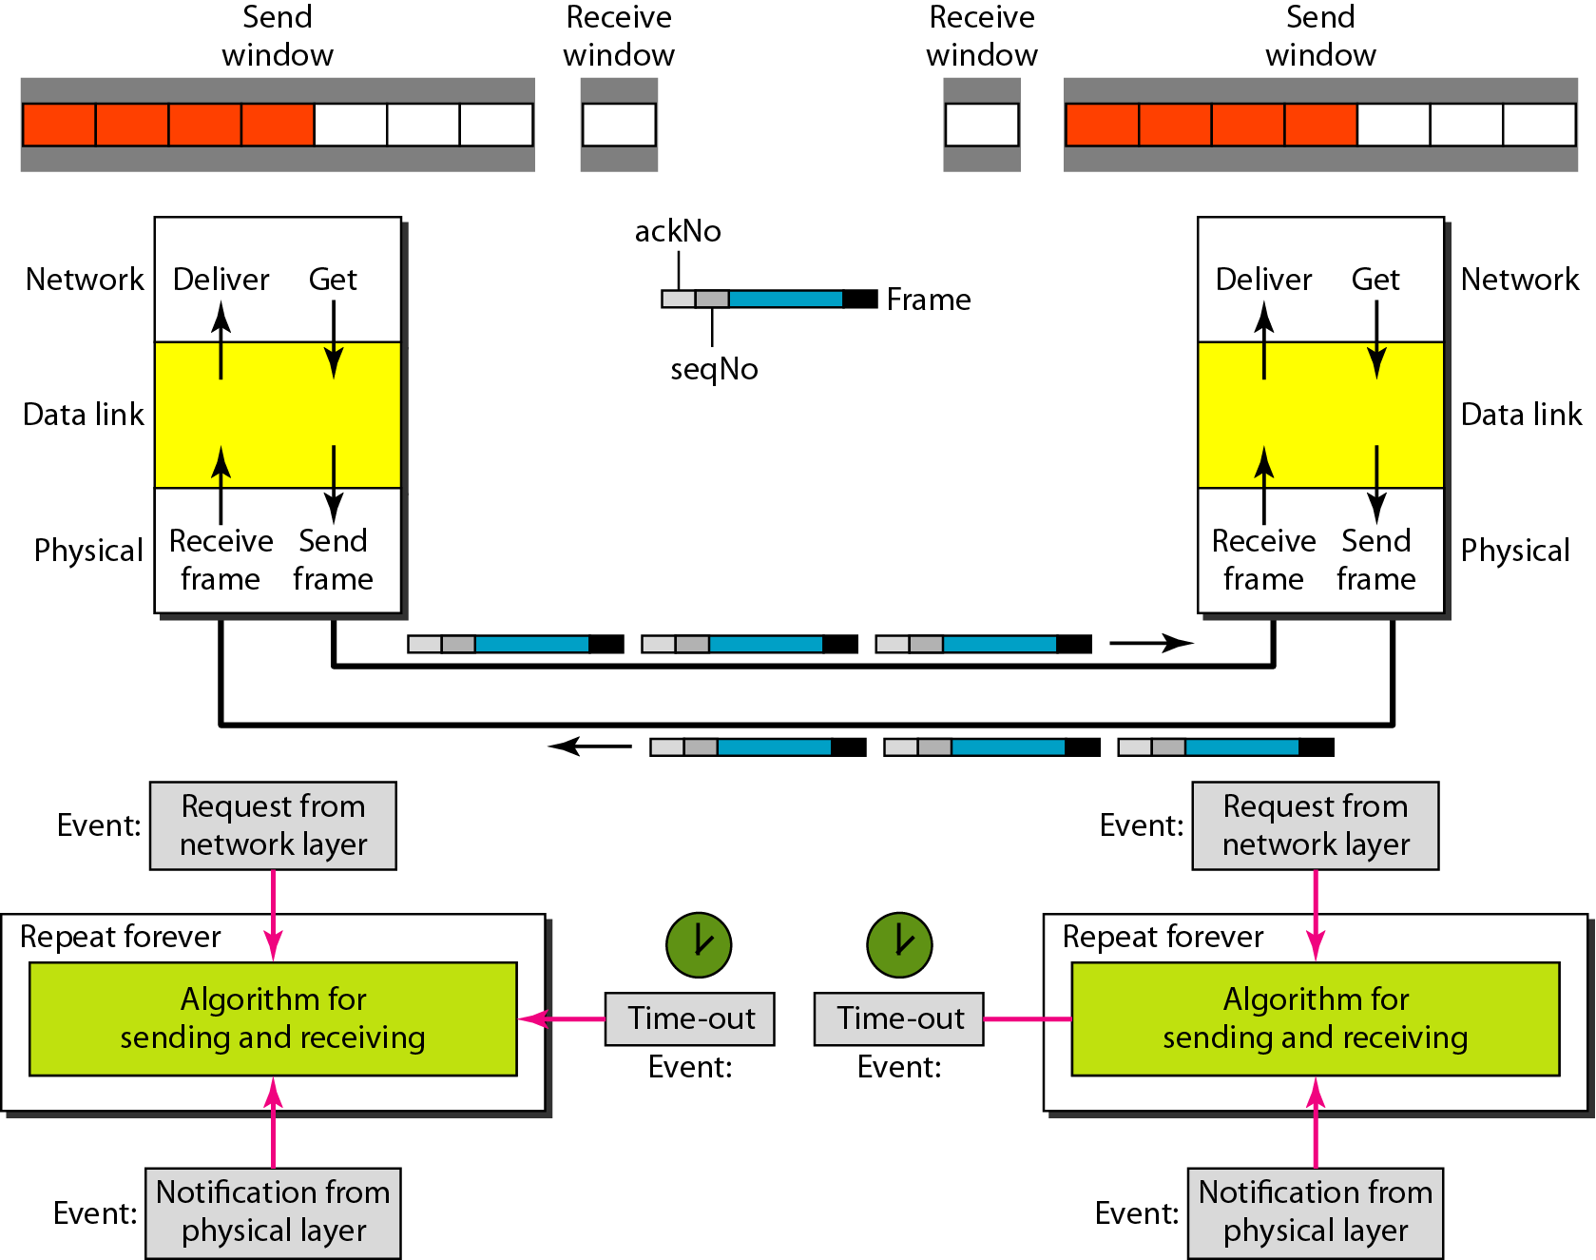
Figure 11.24 Design of piggybacking in Go-Back-N ARQ

Slide 134
11-6 HDLC
High-level Data Link Control (HDLC) is a bit-oriented protocol for communication over point-to-point and multipoint links. It implements the ARQ mechanisms we discussed in this chapter.
Topics discussed in this section:
Configurations and Transfer Modes Frames Control Field

Slide 135
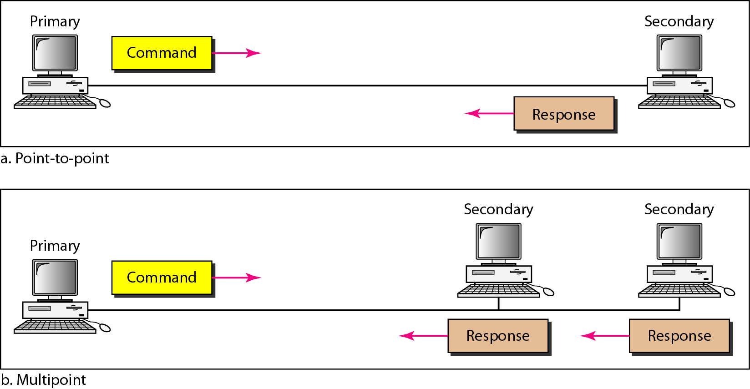
Figure 11.25 Normal response mode

Slide 136
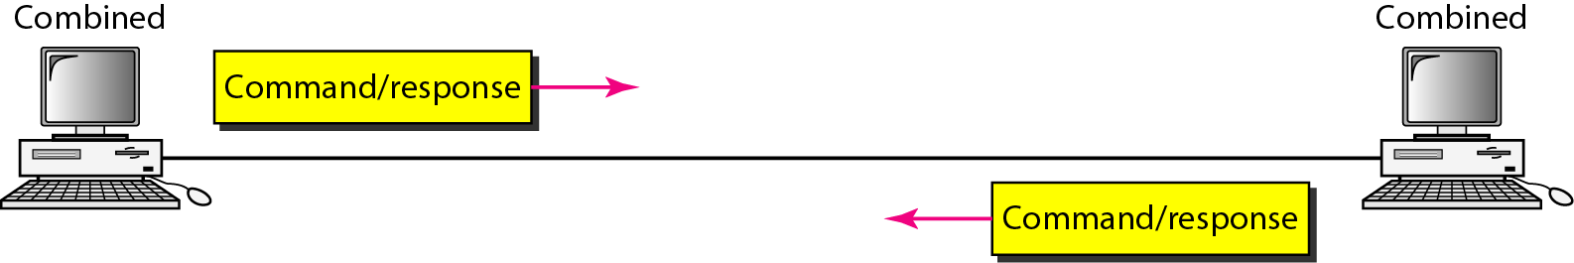
Figure 11.26 Asynchronous balanced mode

Slide 137
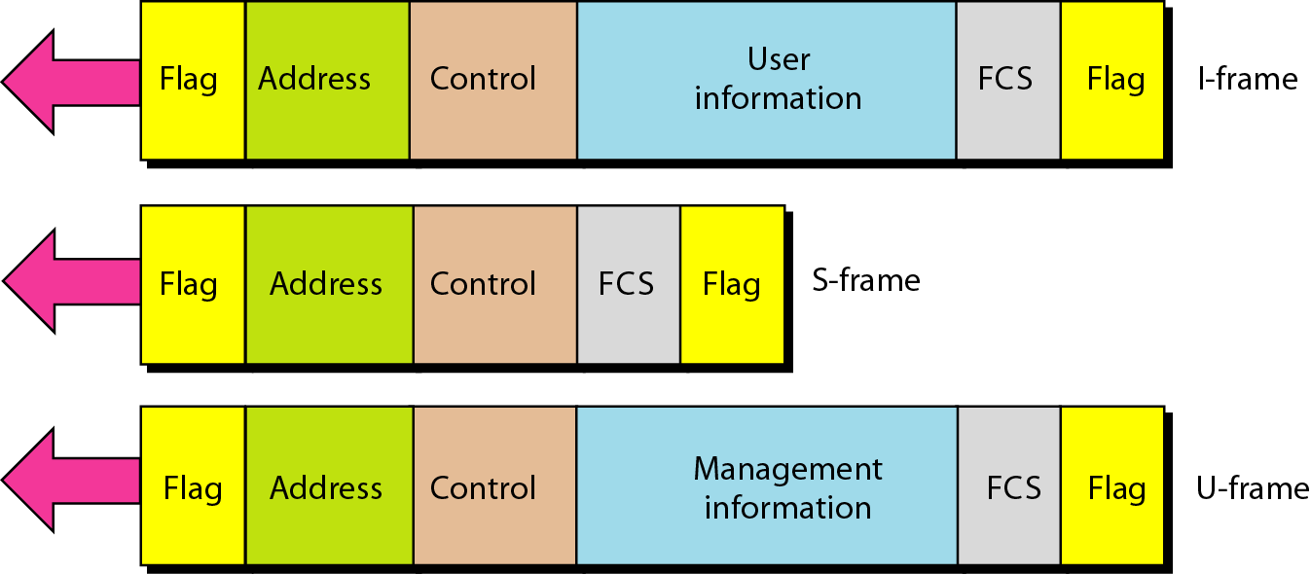
Figure 11.27 HDLC frames

Slide 138
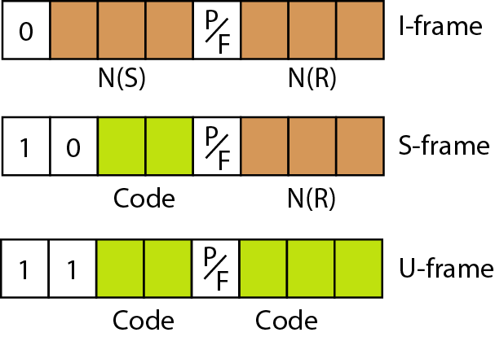
Figure 11.28 Control field format for the different frame types

Slide 139
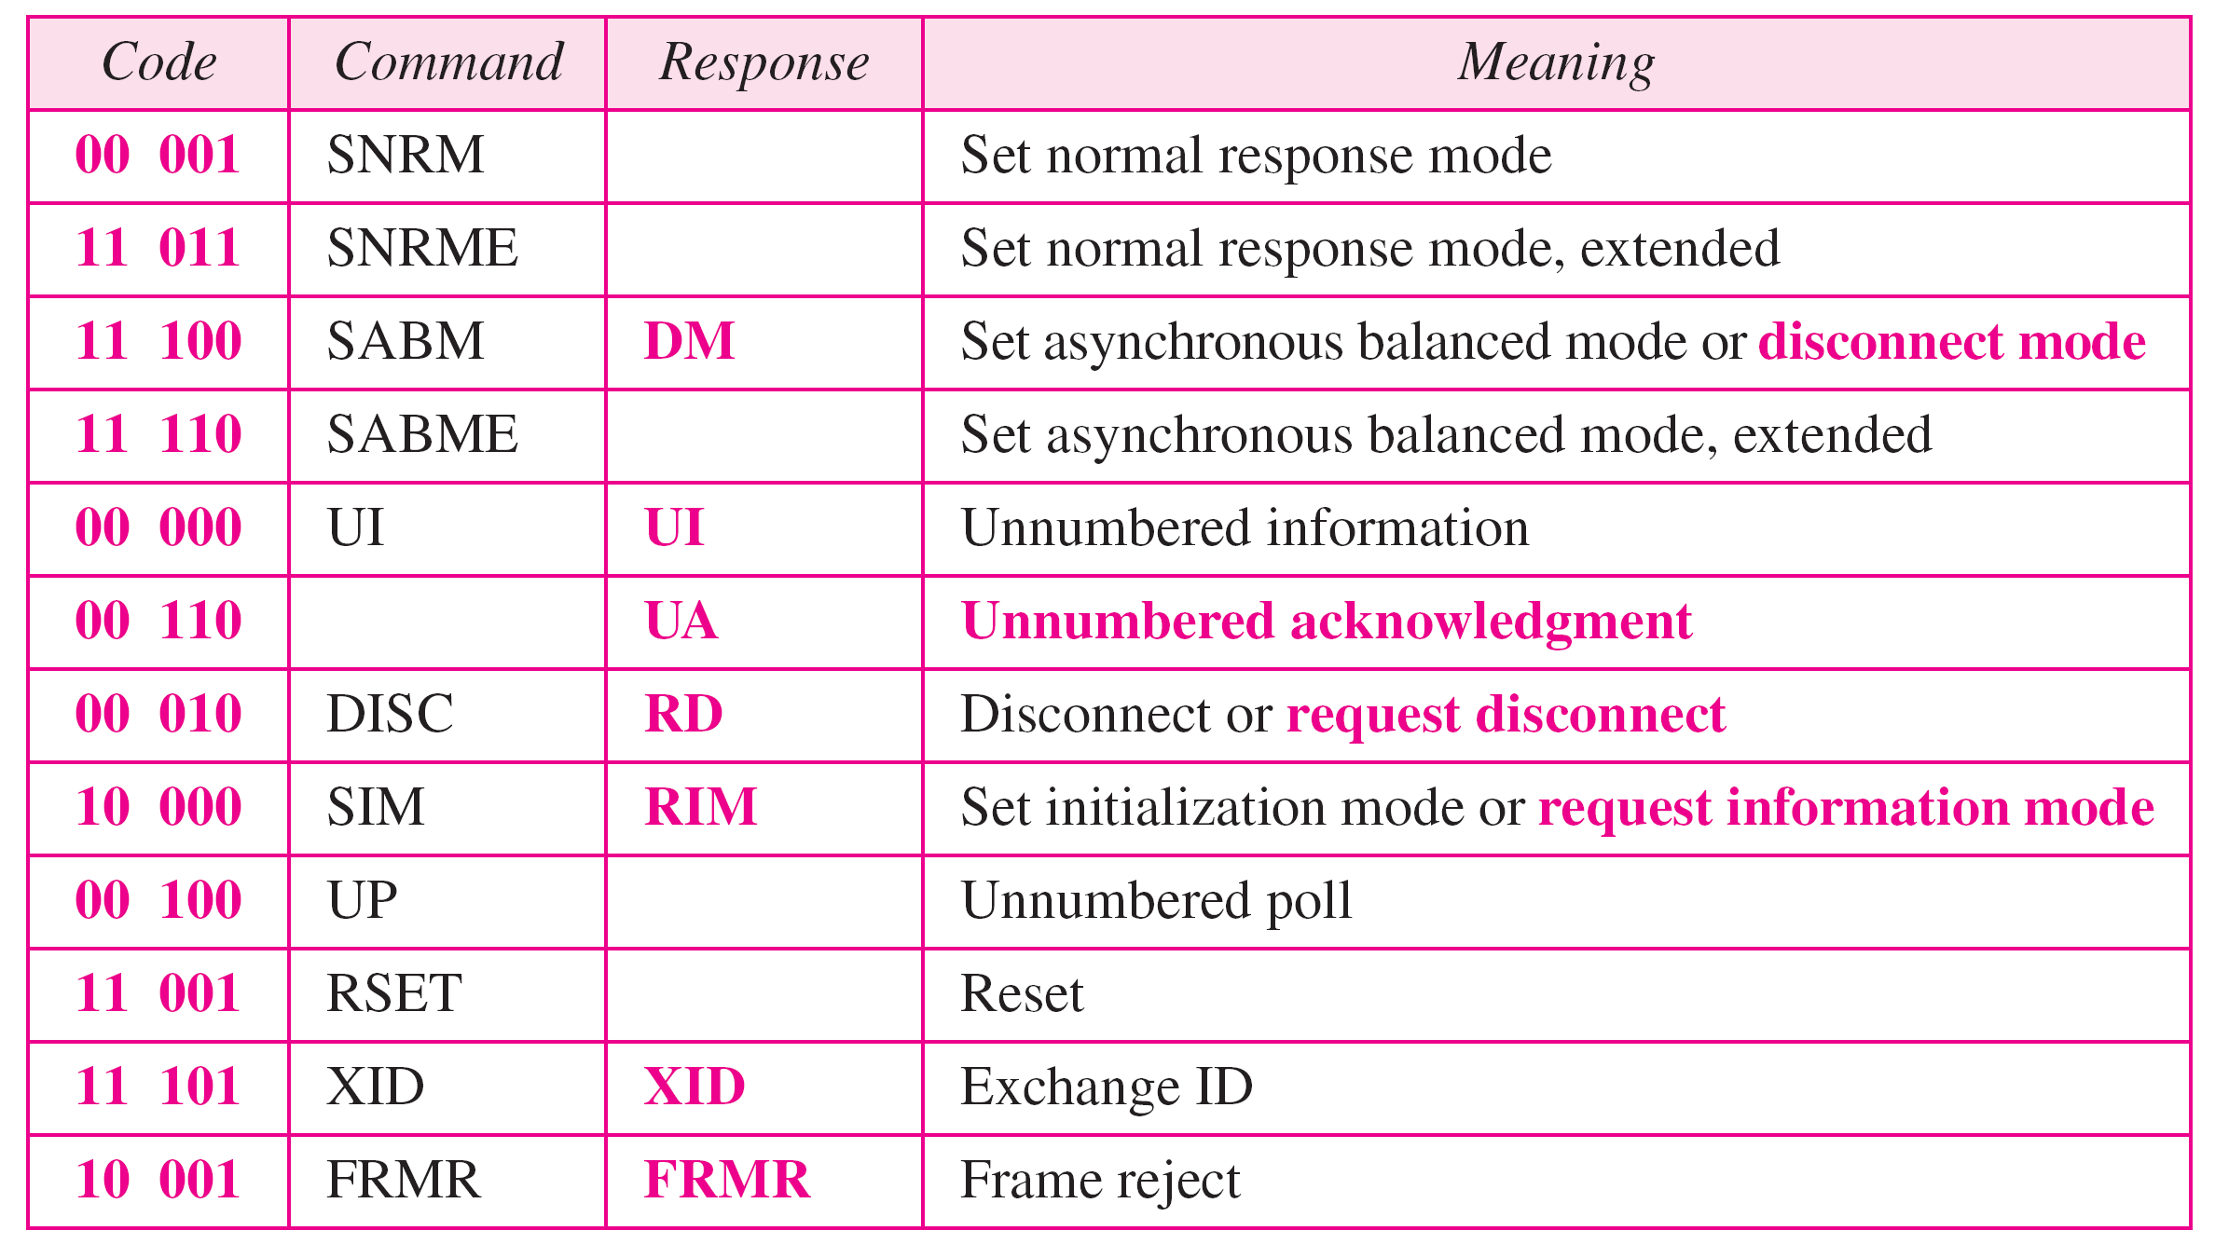
Table 11.1 U-frame control command and response

Slide 140
11-7 POINT-TO-POINT PROTOCOL
Although HDLC is a general protocol that can be used for both point-to-point and multipoint configurations, one of the most common protocols for point-to-point access is the Point-to-Point Protocol (PPP). PPP is a byte-oriented protocol.
Topics discussed in this section:
Framing
Transition Phases

Slide 141
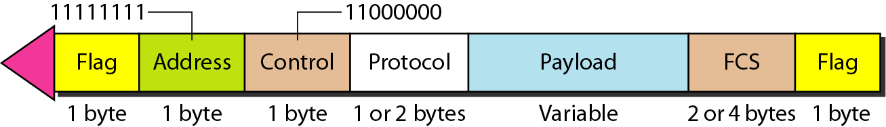
Figure 11.32 PPP frame format

Slide 142
Note
PPP is a byte-oriented protocol using byte stuffing with the escape byte 01111101.

Slide 143

Figure 11.33 Transition phases

Slide 144

Figure 11.35 LCP packet encapsulated in a frame

Slide 145
Protocol Verification
Finite State Machined Models
Petri Net Models

Slide 146

Finite State Machined Models
(a) State diagram for protocol 3. (b) Transmissions.

Slide 147

Petri Net Models
A Petri net with two places and two transitions.

Slide 148

Petri Net Models (2)
A Petri net model for – Simplex protocol for noisy Channel

